Slide 1
Electric Vehicle Committee Open House
Tuesday 2/12/19 7:00pm-8:30pm
Notes:
This deck has been annotated as of 2/12/2019 to help community members understand the content who were not present.
The purpose of this open house is to inform, help answer questions, but especially to share information about Electric Vehicles, the logistics of charging, available cars today, charging terminology, thinking about traveling with an EV, etc

Slide 2
Agenda
Club Room (30m)
Briefing Deck
Questions & Answers
Walking tour (30m)
EV-1 Charging Amenity on Level A
Main Electrical Room
Garage Walk
Notes:
The first half of the meeting will be dedicated to presenting this deck and having a discussion.
Following the club room portion, the group will walk through the garage.

Slide 3
Goals and outcome
Broad understanding of EVs, logistics of charging
Awareness of the building’s electrical infrastructure, capacity & possibilities
Tour of garage, amenity and any on-site EVs (Tesla Model 3, Nissan Leaf, Chevy Volt)
Opportunity for owners to network and express interest, Q&A in forward-looking options
Gathering feedback on draft Limited Common EV Charging Policy
Notes:
Goals
Information broadly made available to interested community members
Understanding of the electrical capacity or upgrades that would help with the infrastructure
Networking and meeting the interested community
To launch in 2019 a policy to help support EV ownership in the condo by allowing for Limited Common parking space investments to be made by owners in electrical charging equipment
Learning Outcome
Community members will have a much more full understanding of Electric Vehicles
Aware of types of plug-in electric cars (PHEV and EV)
Awareness of charging terminology and types of technology

Slide 4
EVs at our association
We have had up to 4 EVs in the building
1 hybrid plug-in owner
1 battery electric vehicle owner
2 additional, other battery electric vehicles (1 rental by an owner; 1 previous renter)
Major chicken-and-egg challenge for our owners
People likely do not want to purchase an EV until they know they have guaranteed charging options
Being an “EV orphan” (not having charging at your home) is a real concern for EV owners
Hard to seek a program and policy without adequate interest
Over 46% of our residents have expressed interest in EVs
Would be great to be able to attract and retain with a fair policy for those who see this as important
Notes:
Today there are 2 primary users of the EV charging amenity which was installed a few years ago. This is great and a few more people could own EVs and still all fairly share the resource.
A primary problem is the chicken-and-egg problem: at our building, people are not interested in buying a true plug-in Electric Vehicle unless there is an approved policy and program that would give them comfort of knowing they could charge in their own parking space. Having to rely on the community charge makes it very hard to think through and execute making a large purchasing decision to buy an EV car. However, without having many EV owners in the building, it’s very hard for the board to understand how much demand there is for such a policy; also, it needs to be built in a way to be fair by making sure users who do end up needing the policy and charging circuits pay their share of the electrical work dedicated to EV chargers. The long-term cost to the association must be $0, and ideally, it would even make some income to help offset any future needs in electrical infrastructure or planning.
This ask has come up many years. It’s time to try and push forward.
Notes updated after the open house:
1 of the vehicles was from when a resident rented an electric car for a week to ‘try out’ the logistics of charging with the community charger. While it was fine for charging, it was not seen as convenient; that owner decided for now not to purchase an EV without a policy and program in place.

Slide 5
Our EV history
2002
2003
2004
2005
2006
2007
2008
2009
2010
2011
2012
2013
2014
2015
2016
2017
Resident asks HOA for EV roadmap
Build sets up EV committee
EV “Wait & See” Decision
Motorcycle Parking
$37,500 Quote – 1 Charger
Renewed EV Interest
Resident moves to Escala Condominium
EV Community Charger Proposal
EV Community Charger Approved /
Wait on private EV
North Tower opens
High Efficiency Light Investments
South Tower opens

Slide 6
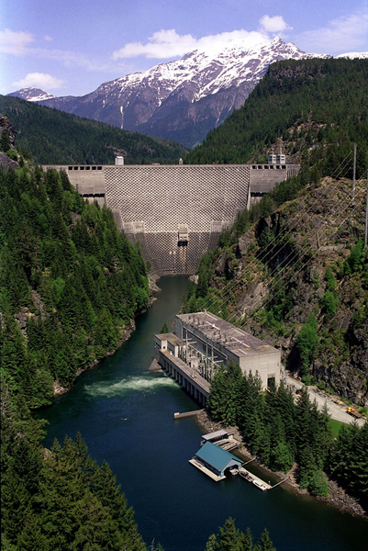
Seattle City Light’s Fuel Mix
Notes:
Electric Cars are as clean as the energy generation used with them. Turns out Seattle City Light has very green power which is great.

Slide 7
EV is Very West Coast
First EV – GM EV-1 (1996), lease-only in California
Modern – Tesla Roadster (2008), built in California
Carbon Fiber in Washington: BMW i3 Moses Lake
Hawaii, Colorado, California, Florida “Right to charge” Laws
Tons of clean hydro electric power – Columbia River
Notes:
Lots of reasons that EVs are big on the west coast.
Of particular note – many states have ‘right to charge’ laws, but Washington does not. Having a policy in place ahead of any right to charge laws is key… in California it’s been an issue where the law allows condo owners to tap into community power without always a defined way to reimburse them. Getting ahead of the curve is key.

Slide 8
EV Adaption – Utility Perspective
PROS
Controllable, predictable load growth
Abundant generation capacity
Robust distribution voltage
CONS
Seattle does not yet have time-of-use incentives
Metering challenges

Slide 9
EV Adaption – Roadblocks according to SCL
Condos & Apartments
Apartments often do not make long-term investments for residents
Condo Boards often are skeptical of owners interested in paying for even their own installations
Assigned (Limited Common) condo buildings have great success with EV, but deeded spaces are a challenge
Cost of install vs gas costs
Single Family Homes
Lack of off-street parking in many dense neighborhoods ideal for EV
Many homes today only have 120-amp service (200 amp required in 2016 for new construction, will help with EV)
Notes:
Takeaway – The Vine is a Limited Common assigned parking building (spaces are assigned in a table and swaps or purchases of spots are done by declaration amendment) – this is easier than deed-based updates to parking. Limited Common improvements are clearly defined and have procedures and text in declarations to cover the process and powers of the board.

Slide 10
EV Incentives and Disincentives
Federal
EV Tax Credit
$7,500 tax credit on some models
After over 200,000 cars by a manufacturer are sold, the credits begin to decrease/halve/expire
WA State
No sales tax on EV infrastructure and charging
EV Tab Surcharge - $150 today, proposed to “$350” (“makes up for lost gas tax revenue”)
Seattle
Residential neighborhoods are highly overprovisioned for energy
SCL
SCL is dealing with the irony of efficiency…
SCL is actively encouraging EV charging to help balance demand
No incentives at this time outside of public investments into charging stations
Notes:
Federal tax credit:
Important – this is a credit and not a refundable credit. If you are planning to buy an EV, consult a tax expert to plan that year’s withholding and other amounts to make sure you qualify for and receive the credit if your vehicle manufacturer is credit eligible.
WA state is expensive for cars especially in the King County area. On top of sales tax and RTA taxes, there is a $150/year EV car fee designed to cover taxes that the gas tax for the car would have had. There is talk of increasing this fee even more, which is super unfortunate.
Seattle City Light is in an interesting spot: the more people conserve, the higher the cost of energy is going; the more people use energy, the higher the cost of energy is going; EVs help balance some. Even though Seattle doesn’t do time-of-day rating for energy use, many people choose to charge their cars at night, meaning it helps balance demand and is a good thing.

Slide 11
2016 Seattle Electric Code
20% of all parking spaces in new construction with >= 20 spaces must have conduit and capacity
Electrical capacity planned for in demand and load calculations
Garage panels and circuit breakers in place
Conduit planned
5% of all spaces must be EV-ready including conduit, wiring, EVSE and/or outlet
New construction condos in Seattle
First Light, Nexus, etc.
EV charging in Limited Common parking spaces is a sales-time upgrade
Like granite or nicer appliances
Also helps them comply with the new Seattle electric code

Slide 12
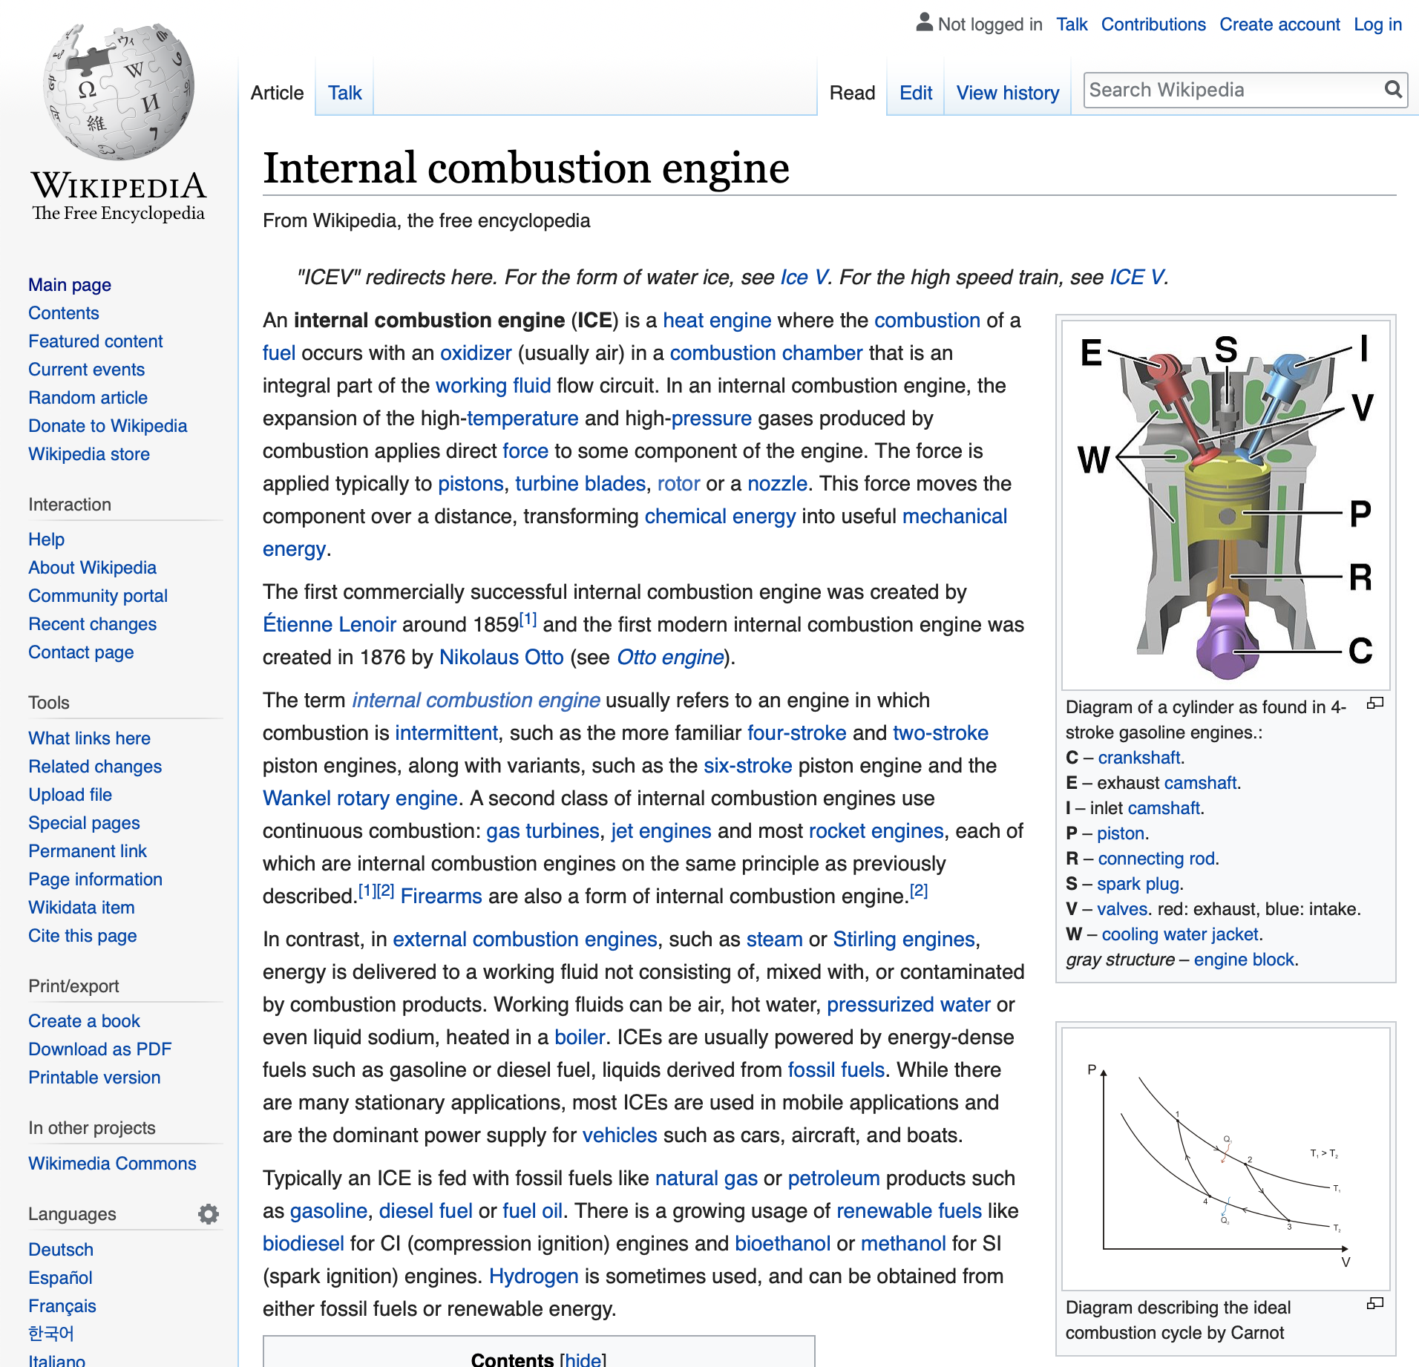
ICE
Notes:
You may hear the term ‘ICE’, it means a standard gas car.

Slide 13
Electric Vehicles Overview
Information sources
First-hand experiences and learnings
Seattle City Light public web site
City of Seattle Plan and As-built records for The Vine (microfilm)
Materials provided under contract with EV Charging Pros (consultants)
Previous conversations, mail threads, board meeting notes from past EV committees
Years of electrician consultations, quotes and conversations at The Vine

Slide 14
Electric Vehicles
Highlights
Zero emission
West coast electric generation fuel mix is very green
“EV Grin”: fun to drive
Lower TOC: no oil changes, less moving parts
Wake up every morning with full capacity
Federal credit of up to $7,500 may be available depending on your situation and the make/model of the EV
Challenges
Charging infrastructure is still in the early stages
Multi-family buildings are more expensive to install chargers in (electric capacity, meters, conduit, HOA negotiations)
“Range anxiety”
Long-term battery state concerns

Slide 15
Energy + types of cars

Slide 16
EV Surprises
Always On
Extremely quiet
Can be jarring to drive an ICE again
Designs from the futuristic to incognito and hidden
Some cars update themselves over time!
City EVs
Thin or small tires and wheels
Handling at highway speeds
Performance EVs
Heavy/large tires/wheels impact range
Acceleration can diminish range

Slide 17
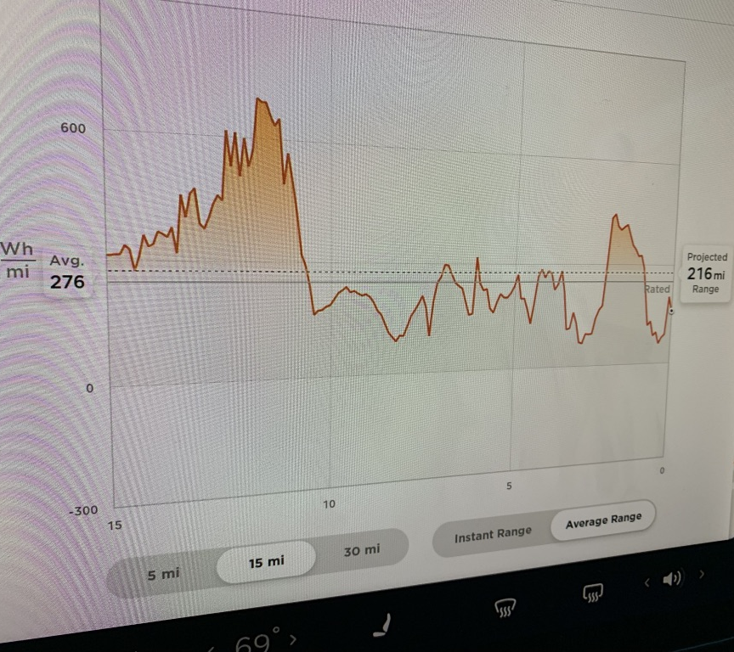
Driving and energy use
Acceleration
Braking
Regenerative breaking
One pedal driving
Climate control
Seat heaters are more efficient than heating air
Air conditioning
Impacts gas cars, too, but it’s harder to see the impact [+ different technologies]
Notes:
In an EV, since you cannot just pull into a gas station to fill up, range anxiety can be a thing. The cars will help you monitor energy use as you go.

Slide 18
Understanding the fuel economy label
Kilowatt (kW) and kW/h
kWh: 12.5¢ US Average, 10¢ Seattle
MPGe
Based on heat comparison
EVs do better in the city with stop/go
Only good at comparing to cost of gas
115,000 BTUs per gallon of gas / 33.7 kilowatt-hours of electricity
Average Fuel Cost
kWh cost per mile * 15,000
Cruising range
100% battery pack charge estimate
Combined cycle, your driving will vary it
Efficiency Rating *new*
Kilowatts per 100 miles on a combined city/highway cycle
Lower is better
Europe is more familiar with: g/100m

Slide 19
Plug-in Hybrid EV (PHEV)
Highlights
Evolution from traditional hybrids
Can plug-in and charge at home
Zero emission during the EV-only portion of a drive
Car manufacturers will offer PHEV options of nearly every model in 2020
Small battery sizes (4-7 kWh) are a relatively small cost of the car
Challenges
Has electric and gas engines: more maintenance, oil changes
Market demand in this segment is shifting away from PHEV and toward pure EV cars without gasoline

Slide 20
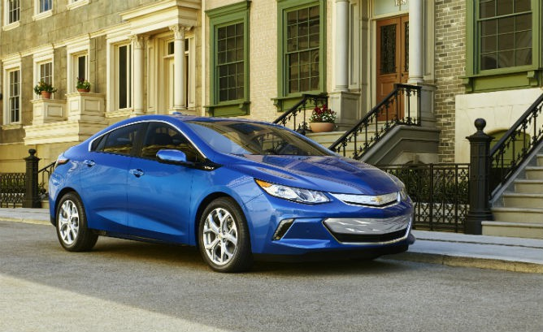
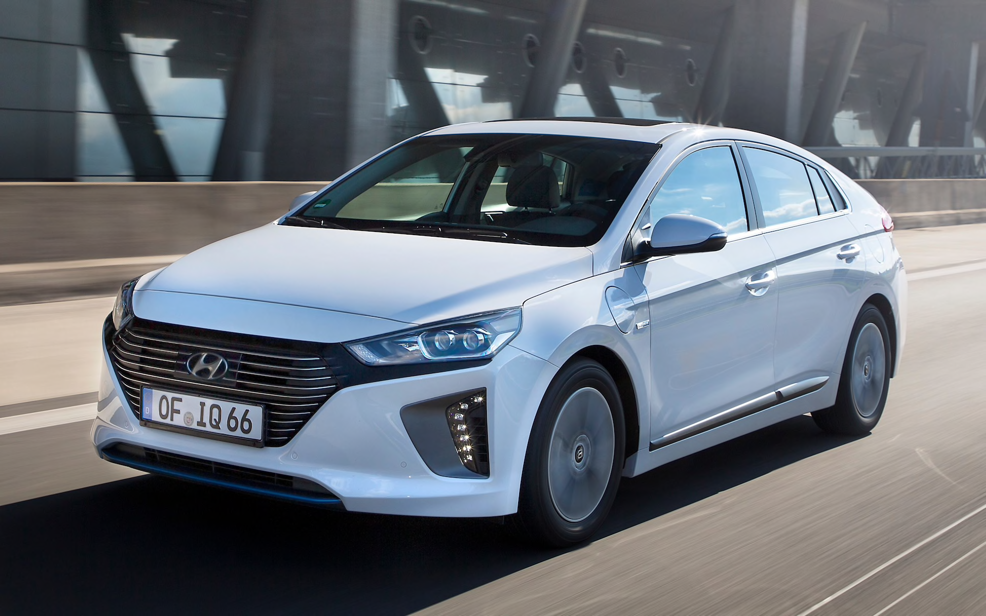
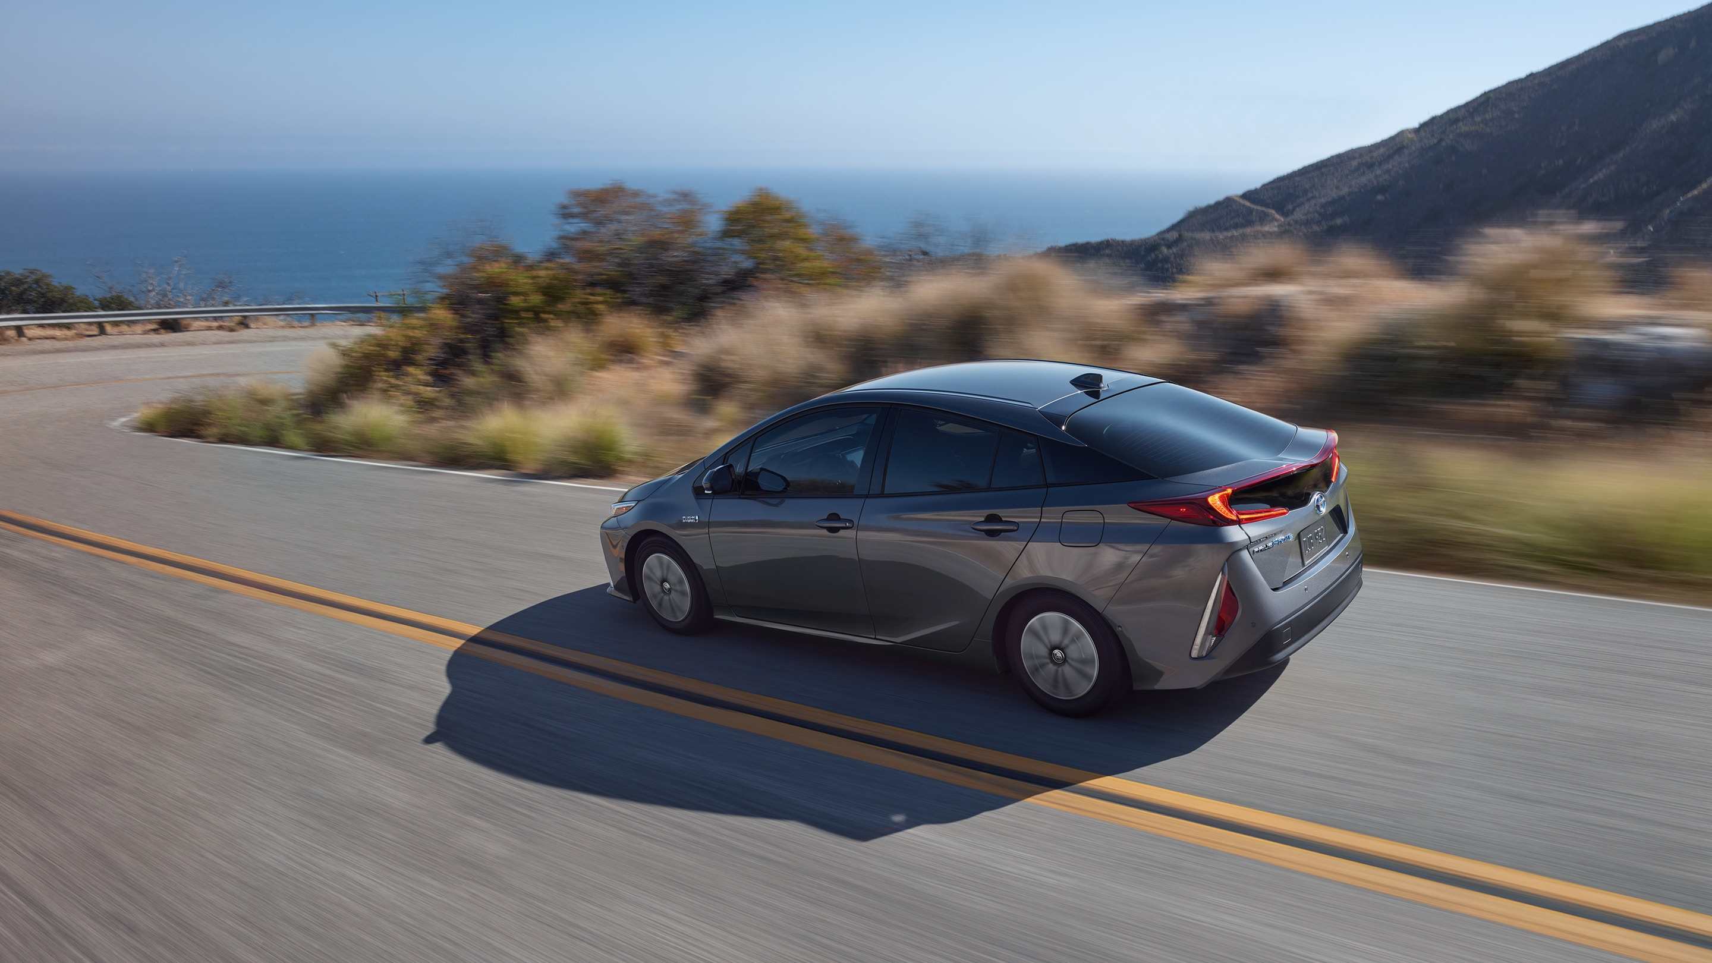
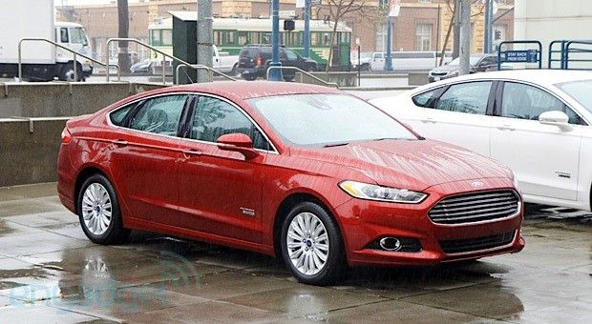
Plug-in Hybrid EV (PHEV)
Chevy Volt
$33K / 53 mi. EV-only / 106 MPGe
* Discontinued just now in 2019
Hyundai Ioniq Plug-in
$25K / 29 mi. EV-only / 119 MPGe
Toyota Prius Prime
$28K / 25 mi. EV-only / 133 MPGe
Ford Fusion Energi
$32K / 21 mi. EV-only / 97 MPGe
Chrysler Pacifica Hybrid PHEV minivan $39K / 33 mi. EV-only / 84 MPGe
Honda Clarity Sedan $34K / 47 mi. EV-only / 110 MPGe
Kia Niro Plug-In $28K / 26 mi. EV-only / 105 MPGe
BMW 330e $46K / 14 mi. EV-only / 71 MPGe

Slide 21
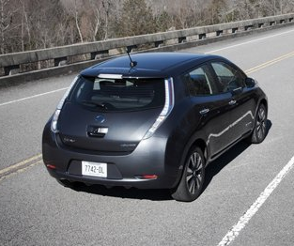
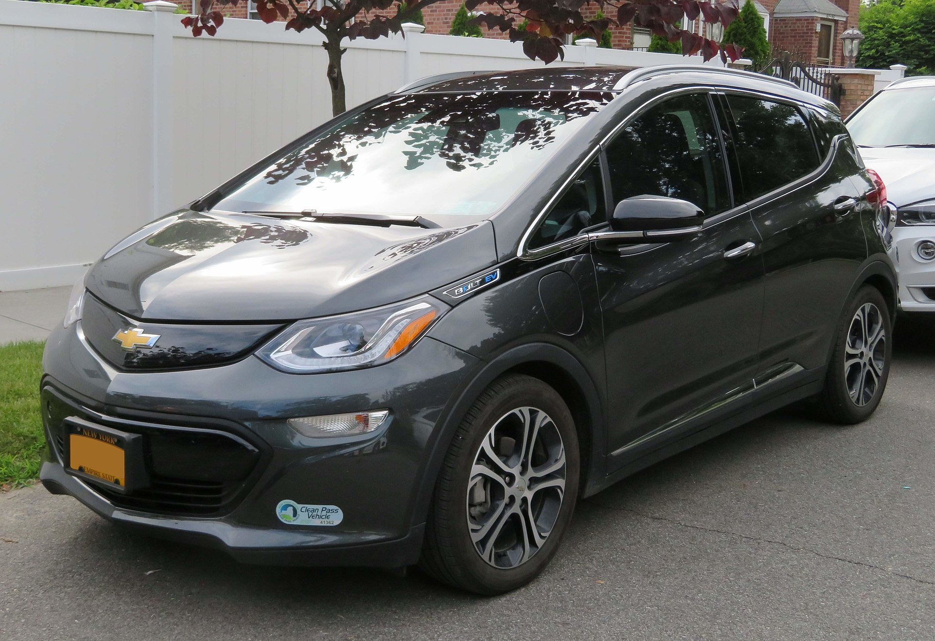
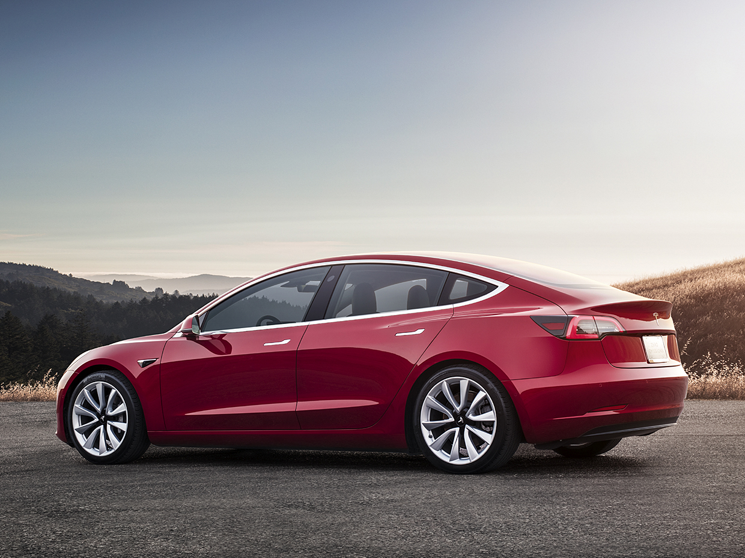
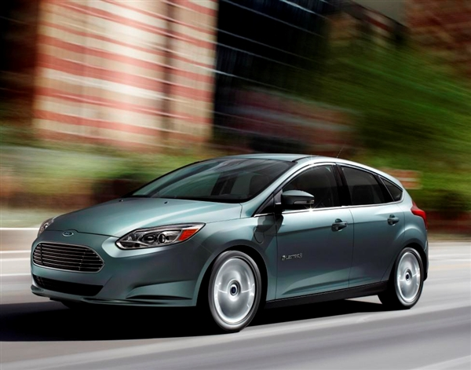
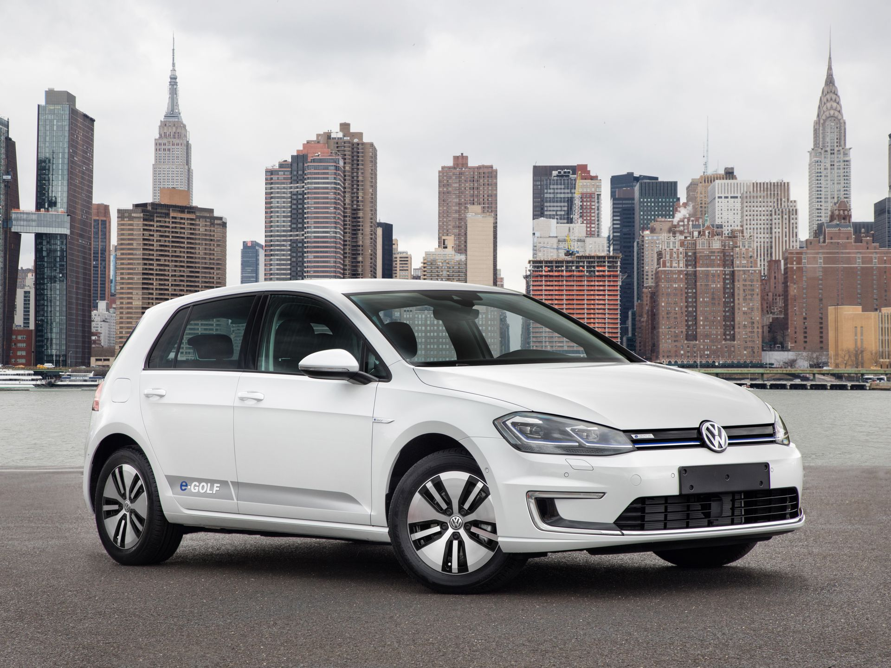
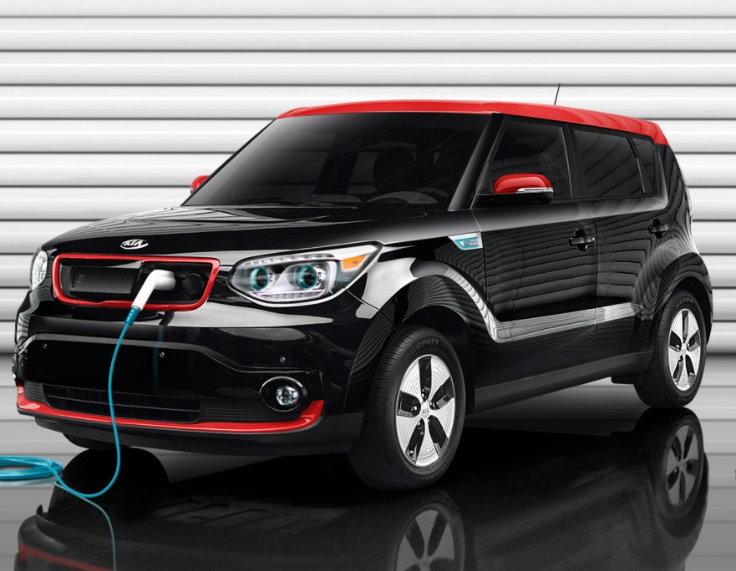
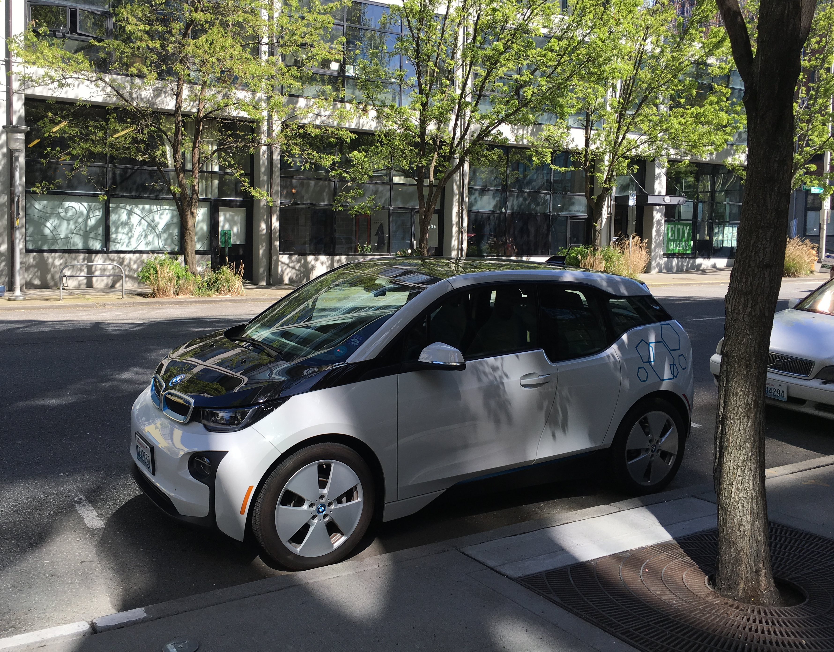
Electric Vehicles 2019
Nissan Leaf
$29K (-$7,500) 40 kWh battery 151 mi. range
Chevy Bolt
$37K (-$7,500; halves 4/1/19) 60 kWh battery 238 mi. range
Tesla Model S
$85K (-$3,750) 100 kWh battery 310 mi. range
Tesla Model 3
$35K RWD Standard 50 kWh 220 mi.
$42.9K (-$3,750) RWD MR 62 kWh 264 mi.
$49K (-$3,750) AWD LR 75 kWh 308 mi.
Hyuandai Ioniq Electric
$31K (-$7,500) 28 kWh battery 124 mi. range
VW e-Golf
$31K (-$7,500) 36 kWh battery 125 mi. range
Kia Soul EV
$34K (-$7,500) 31 kWh 93 mi. range
BMW i3
$45K (-$7,500) / also available as a PHEV
42 kWh battery 81 mi. range
Notes:
Leaf, Bolt, Model 3 are super popular cars out there now.

Slide 22
USA PHEV/EV Top-10 Sales Figures
2018 Sales
Tesla Model 3 EV | 139,782
Toyota Prius Prime PHEV | 27,595
Tesla Model X EV | 26,100
Tesla Model S EV | 25,745
Honda Clarity PHEV | 18,602
Chevy Volt PHEV | 18,306
Chevy Bolt EV | 18,019
Nissan Leaf EV | 14,715
BMW 530e PHEV | 8,664
Ford Fusion Energi PHEV | 8,074
2017 Sales
Tesla Model S EV | 27,060
Chevy Bolt EV | 23,297
Tesla Model X EV | 21,315
Toyota Prius Prime PHEV | 20,936
Chevy Volt PHEV | 20,349
Nissan Leaf EV | 11,230
Ford Fusion Energi PHEV | 9,632
BMW i3 EV | 6,276
Fiat 500e EV | 5,380
BMW x5 sDrive40e PHEV | 5,349
Notes:
Lots of popular options!

Slide 23
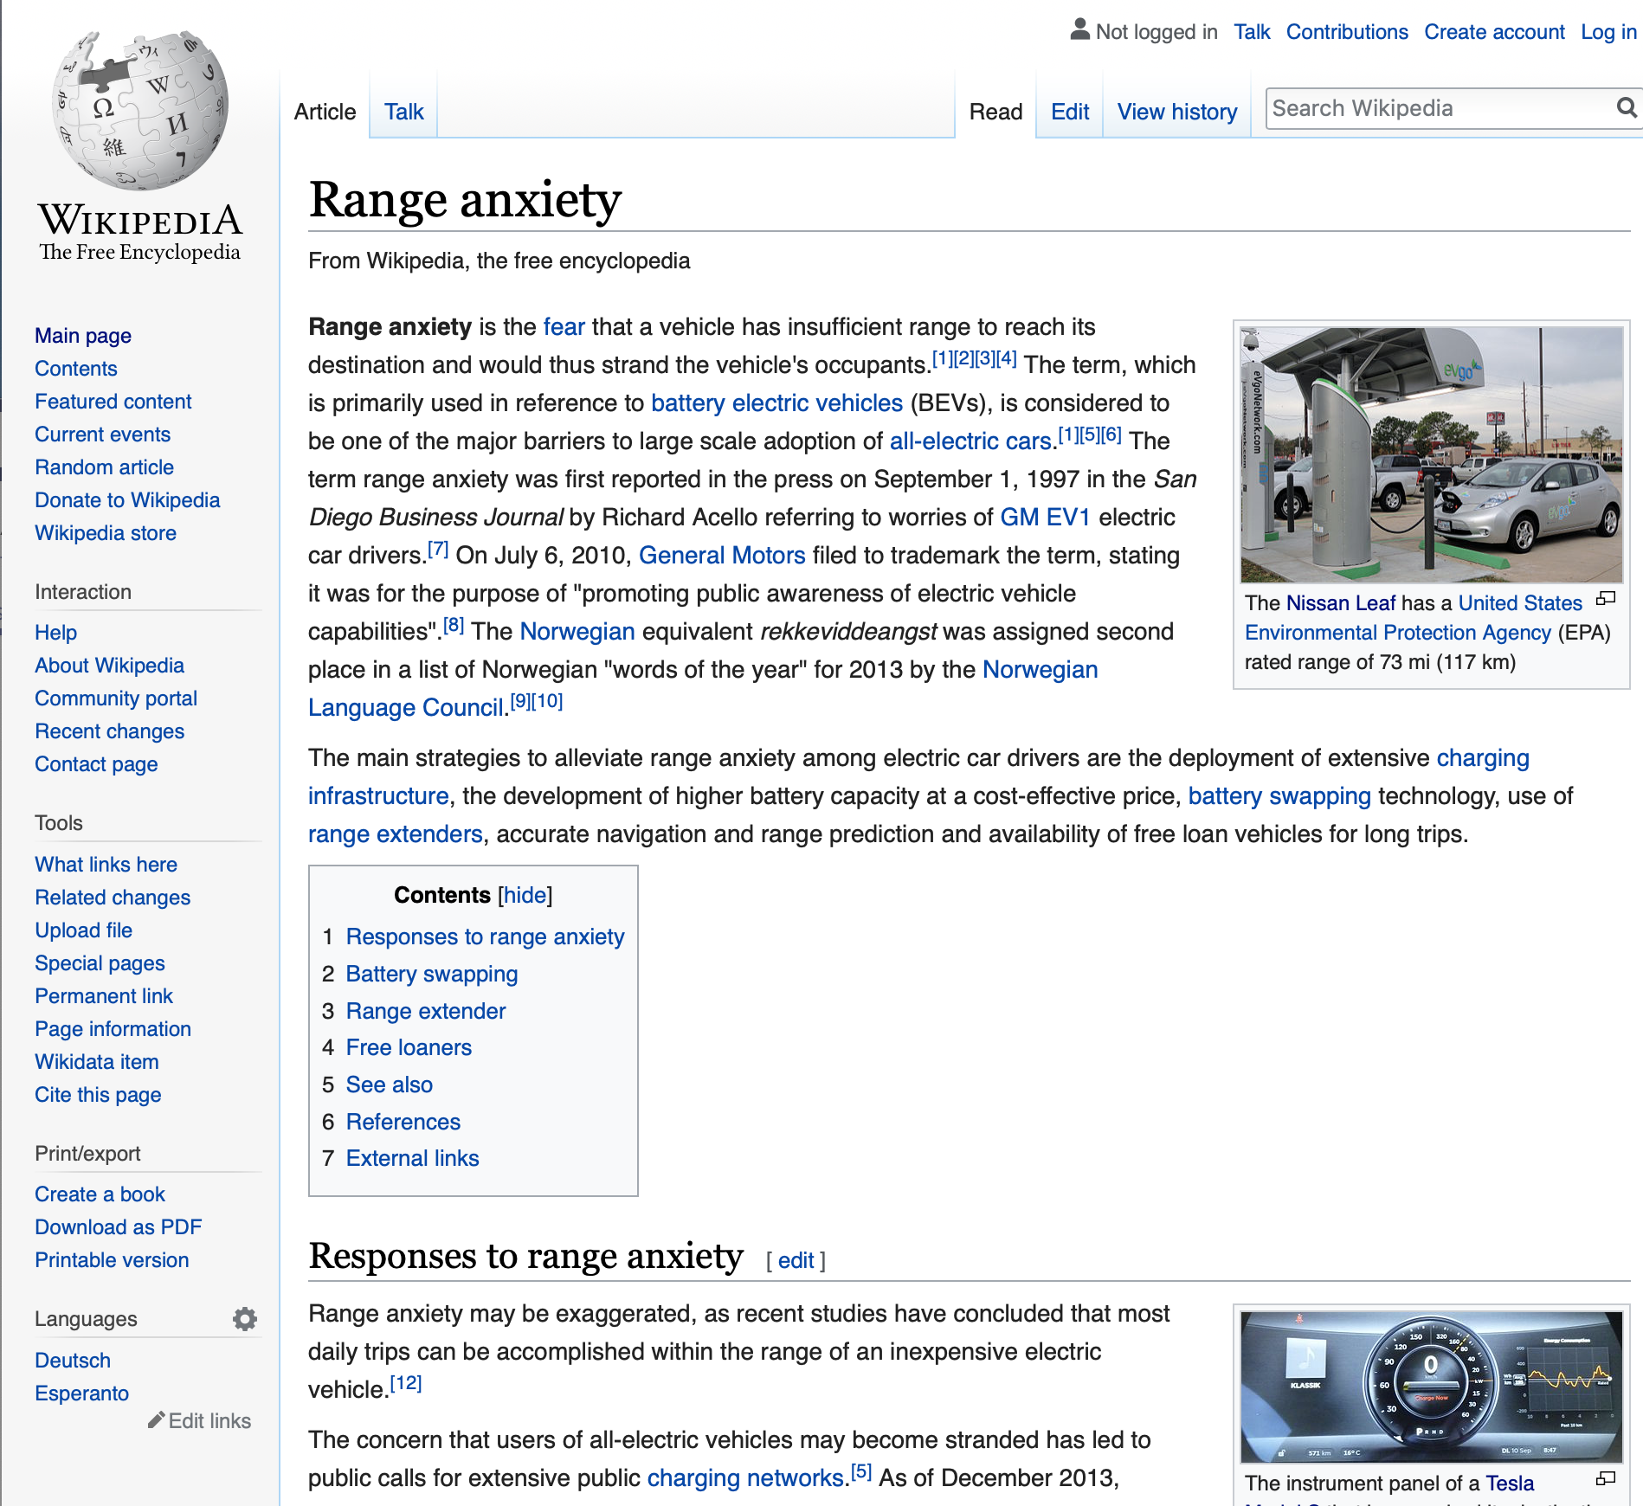

Slide 24
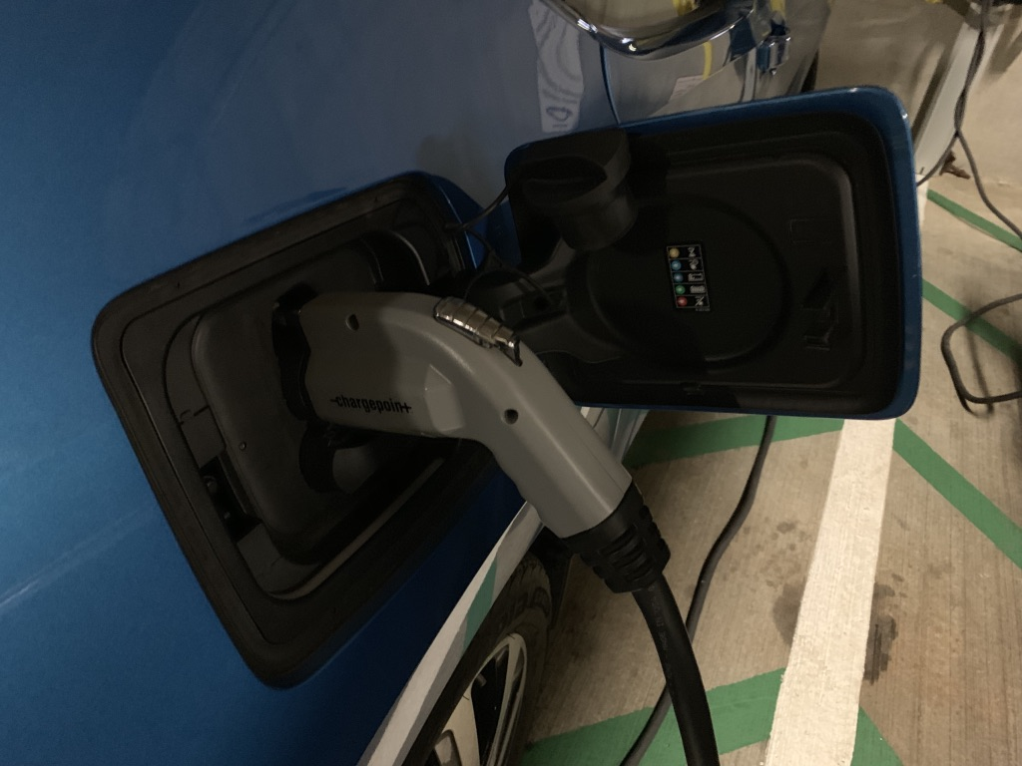
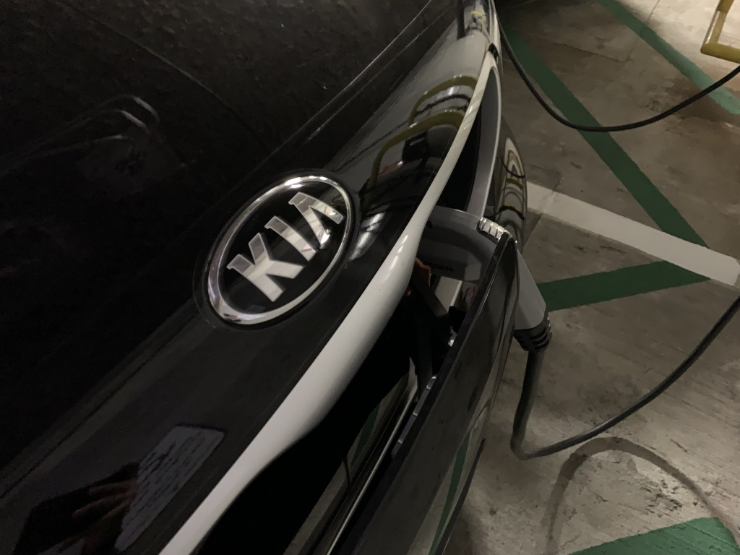
EV Charging
Basics
Equipment
Outlet types
Levels of Charging
Where to charge
At home
On the go
Traveling
Top left: Nissan Leaf charging UI in car
Top right: BMW i3 charge port on side of car
Bottom right: KIA Ionic charging in front bumper

Slide 25
Common Charging Equipment
Dedicated EVSE
Electric Vehicle Supply Equipment
Hard-wired or plug-in
Mobile Connector
Travels with vehicle
May include adapters
RV plugs, wall plugs, …
Adapters/Cord
J1772 Cord
CHAdeMO
CCS
Tesla Connector

Slide 26
EV Charging Basics
80-90% (vehicle dependent) is a daily charge target
Modern EVs let you configure schedule, when to turn off charging
Aim to keep charge at or above 20%
ABC: Always Be Charging
Plug in every night and awake to a daily charge
Ideal for long-term battery health
“Vampire Drain”
Nightly loss of energy, normal
OK to leave a car parked for a week
Longer term parking should be left connected, trickle charging, or shutdown first

Slide 27
Levels of Charging
Level I | Level II | Level III
120V AC 15-20-amp dedicated circuit Trickle Charge | 240V AC 20-100-amp dedicated circuit 4-8 hours to charge | 480V DC 140-1,000 amps 20-50 minutes to charge
Common in single family garages | Modern choice for charging Focus of this briefing | Specialized electrical infrastructure Not all EVs accept all DC chargers
NEMA 5-15 Wall Outlet NEMA 5-20 Wall Outlet | NEMA 14-50 Wall Outlet Clipper Creek EVSE ChargePoint EVSE Tesla Wall Connector EVSE | CHAdeMO Combined Charging System (CCS)
 | ChargePoint Network EVgo Network J1772 charging stations Tesla Destination Chargers | EVgo DC Network Electricy America DC Tesla Supercharger
Notes:
Level 1 charging can take more than 1-2 days to charge some electric cars, it’s very trickle.
Level 2 charging is the ideal home charging situation.
Level 3 is used while traveling typically.

Slide 28
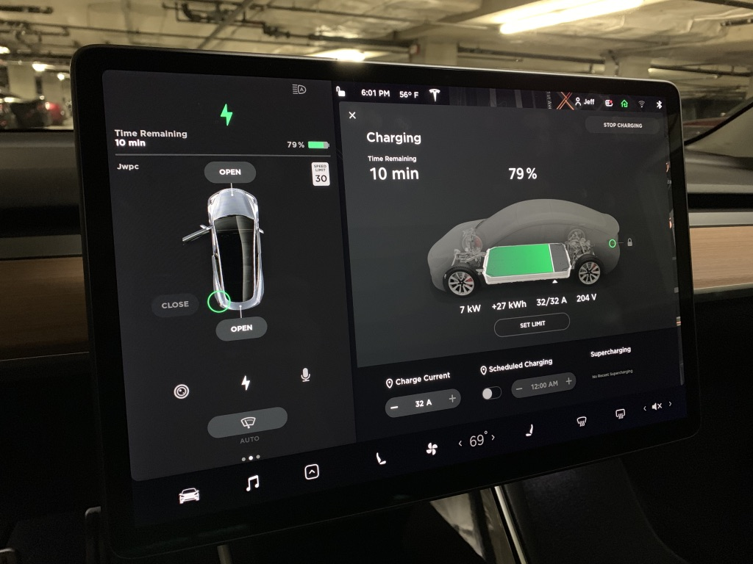
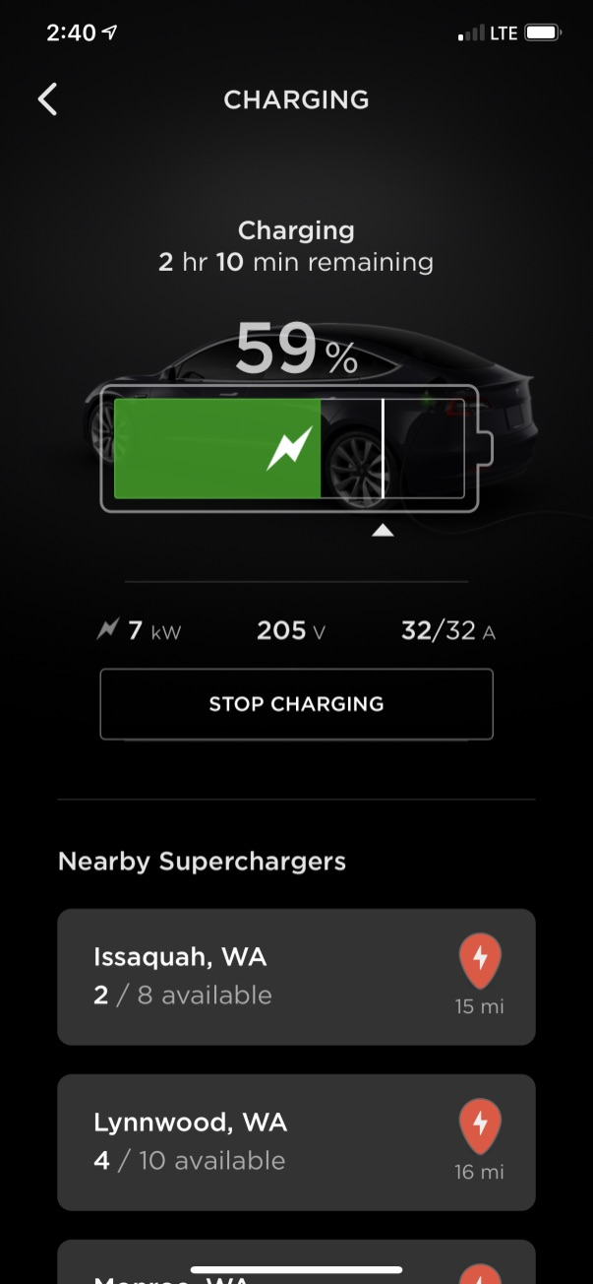
Right: Tesla Model 3 screen during charge
Bottom: Tesla iPhone app (shows charge status, sends a text message when charging finishes)
xz
Notes:
These screenshots are from a Tesla Model 3.
On the left is an iPhone app giving you status updates during a charge. When charging hits the limit you want to charge to, a notification comes to the phone and it shuts off charging.
Inside the car you can see a similar view, configure scheduled charging each day, etc.

Slide 29
Workplace / charging on the go

Slide 30
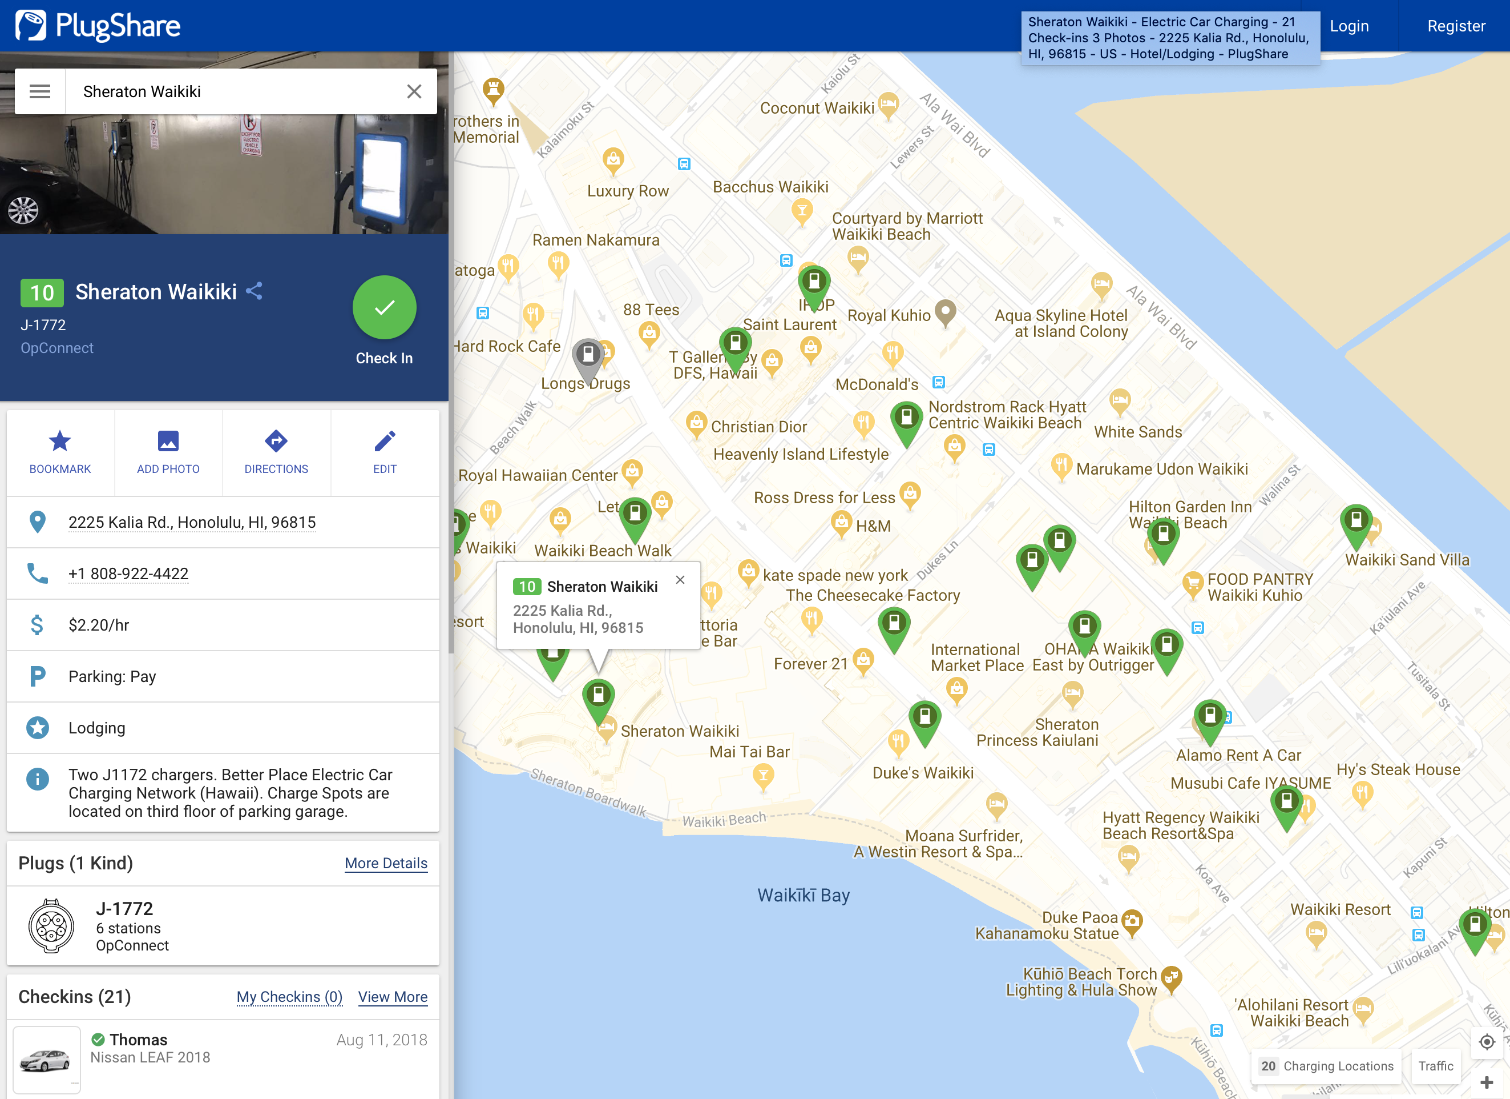
Notes:
Plugshare.com and its apps: a community where people post info about nearby chargers, the types of connectors, whether it is a paid charger, or how much it costs, etc. Very helpful to help with planning! Many hotels have chargers just for their registered guests while shopping malls and movie theaters often have charging as a free or cheap amenity.

Slide 31
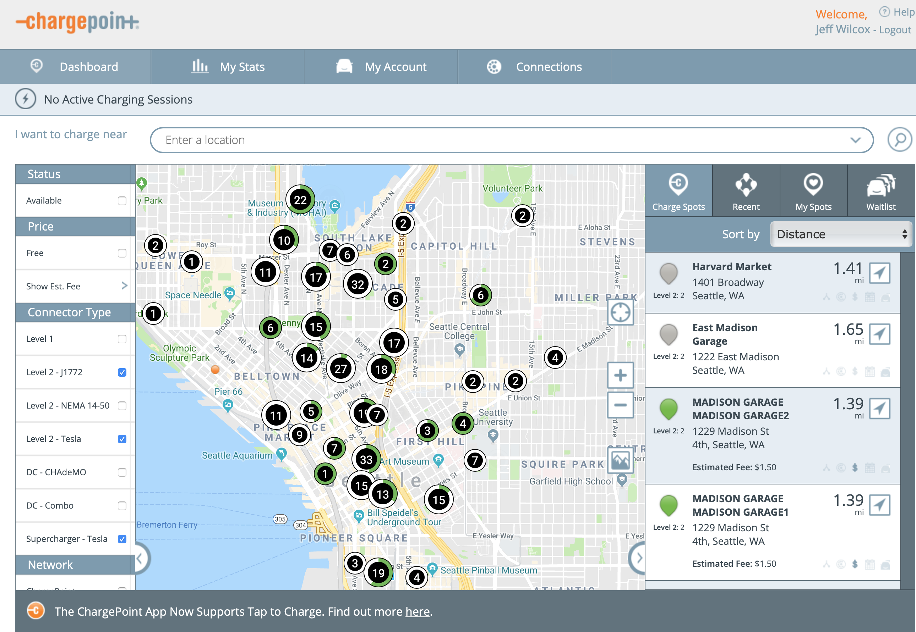
Notes:
Chargepoint.com is the largest network of chargers. With a phone app or a small key fob you can gain access to start the charging. Rates are set by property owners or their network and vary quite a bit. Their app shows real-time availability of how many chargers are in use.

Slide 32
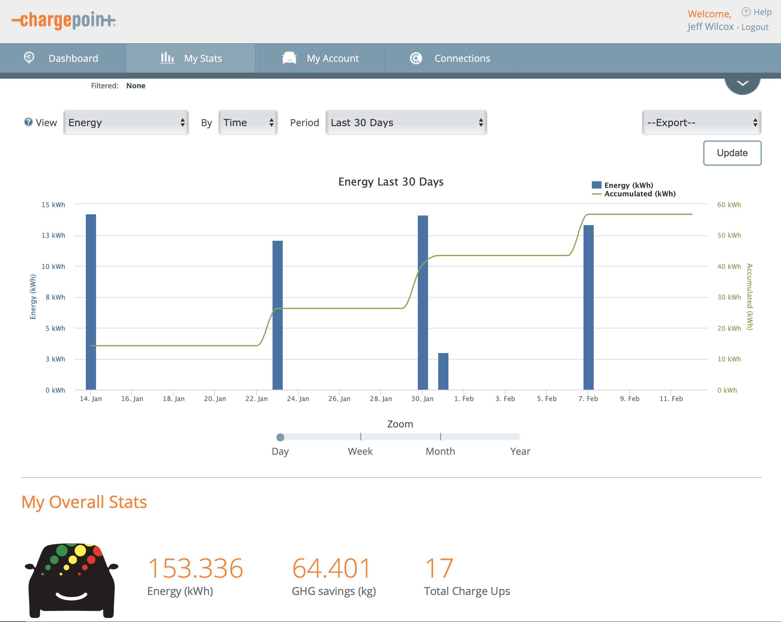
Notes:
ChargePoint tracks over time your charging, how much energy you have put in the car through their stations, costs, etc.

Slide 33
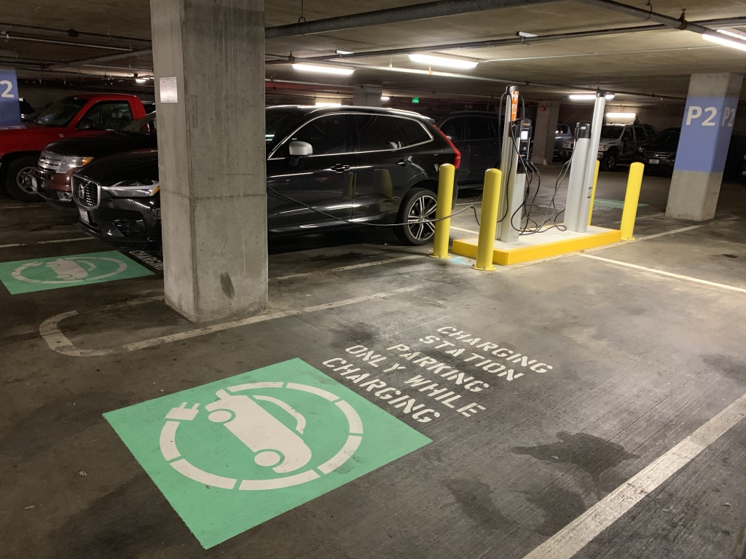
UW
Free / Varies
ChargePoint network
Level 2
Charges car in 4-8 hours
Notes:
Some places have free charging, or with paid parking, charging is free. Here is one of the UW medical center charging bays with 4 charging stations for example.

Slide 34
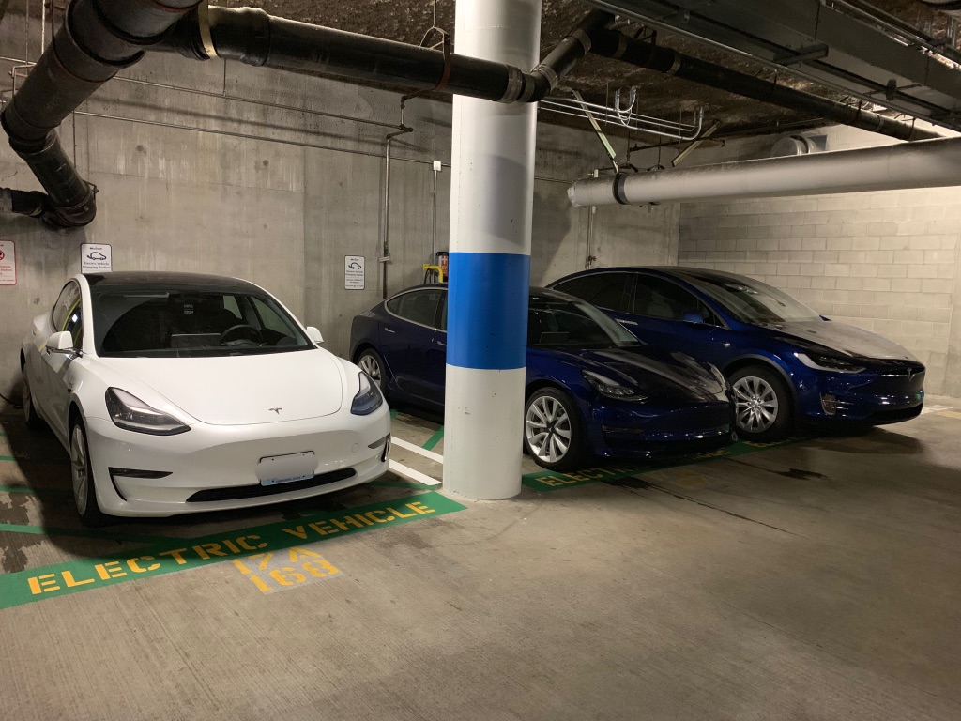
Employer
Level 2 ChargePoint Network
Free for carpooling employees
Paid by the hour otherwise
Notes:
Here are charging spots powered by ChargePoint in a corporate employer, open to their employees, with different rates depending on whether carpooling (free!) or not.

Slide 35
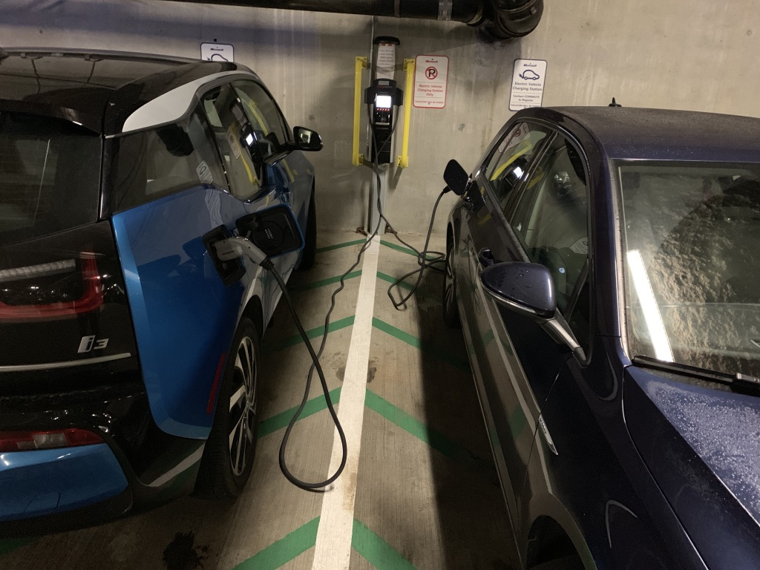
Employer
Price rises at 4-hour mark
Digital Waitlist
Notes:
Busy charging stations may support a ‘waitlist’ where you can get in line to charge when ready. Here a BMW i3 and a VW are charging.

Slide 36
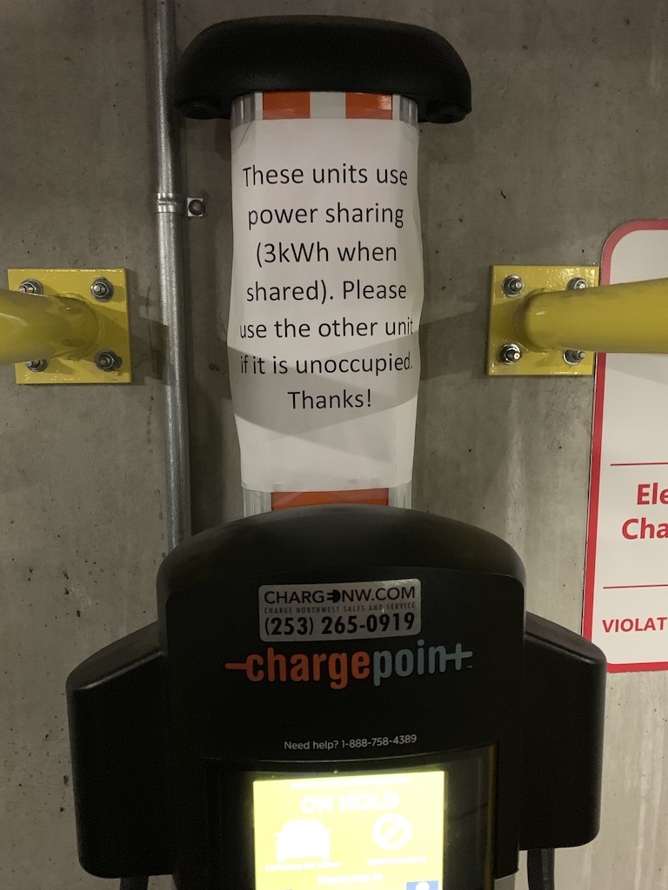
Load sharing
Common in commercial chargers
Can slow down charging
May make time-based charges $$
Notes:
Many commercial chargers are ‘load sharing’, meaning that 2 spaces share 1 circuit of power, and so if 2 cars plug in, they both charge at half speed. Important to be aware of in bays of 4 or more chargers where you should not park next to another EV to get a faster charge.
While load sharing could be useful to get more chargers in a building like The Vine, it’s very challenging or impossible to have per-charger sub-meters for power, meaning it’s hard to let people pay fairly for their share without investing in networked, expensive-to-manage systems like ChargePoint.

Slide 37
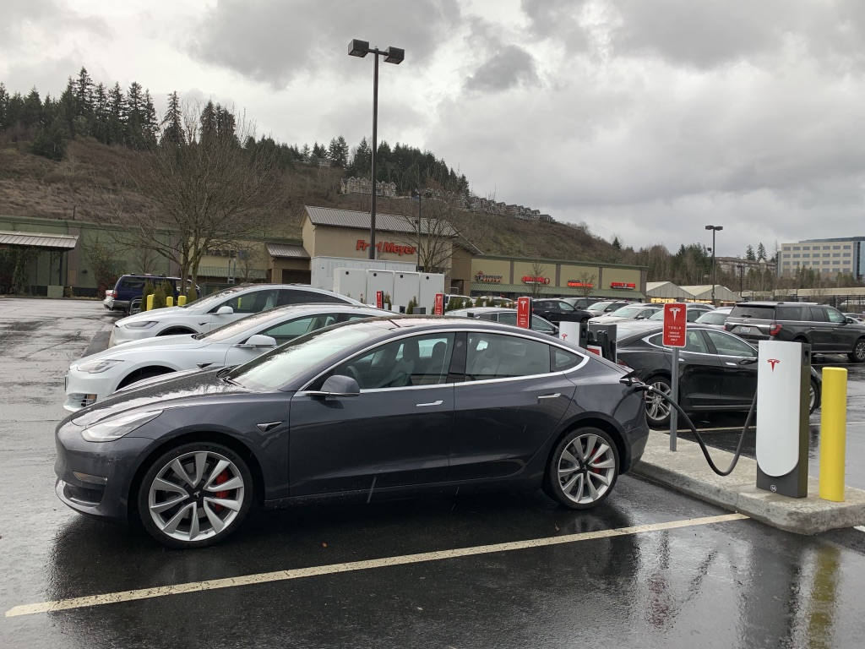
Fred Meyer Issaquah
Urban Tesla Supercharger
Charges car in 20-40 minutes
Price varies by car/plan
Notes:
Here is a Fred Meyer store in Issaquah. The Tesla Superchargers there can charge a car in 20-30 minutes while you are shopping inside. The Tesla cars use this custom network and adapter so only their cars are able to take advantage – it’s one of their perks. They are paid on some models and free for others.

Slide 38
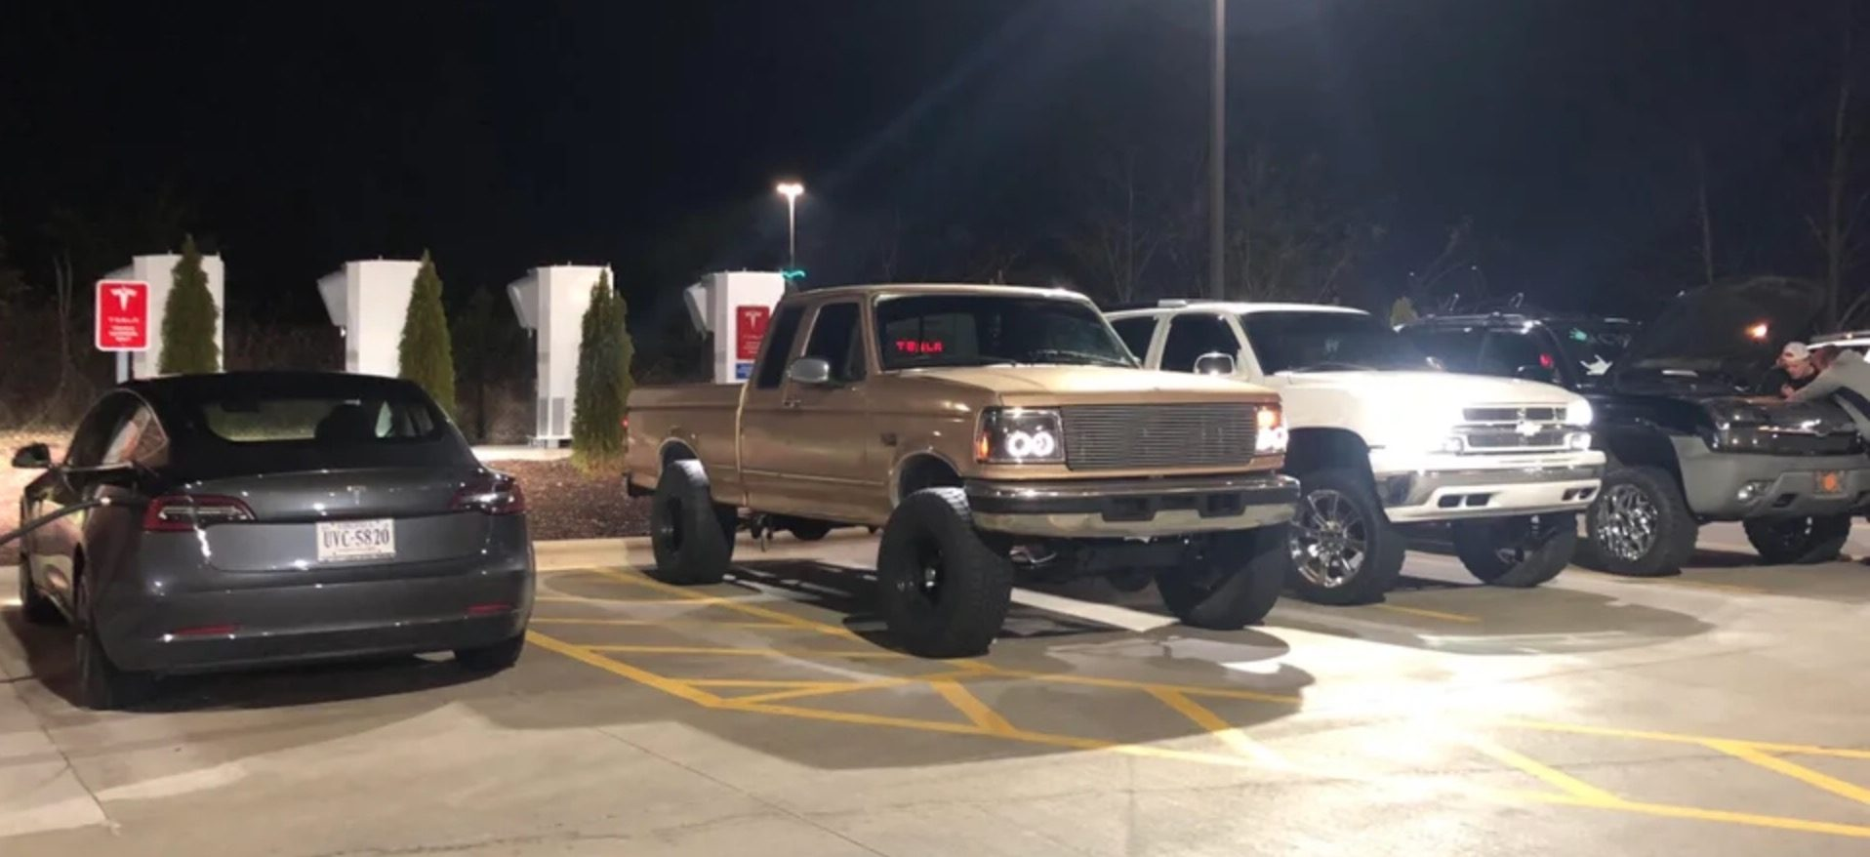
“Icing”
When ICE vehicles park in EV charging spots
Sometimes just an awareness issue
Similar to parking in handicap parking spaces in congested garages and cities
Enforcement & laws vary by state
RCW 46.08.185: $124 fine, public or private property if not connected to charging equipment and property marked signage (signage as well as green pavement markings)
EVs also ICE
Very poor behavior
Bellevue, WA has a particular problem with EV “ICing”
Charging stations are being relocated away from prime/handicap parking spaces to fix
Notes:
You may have heard of this on the news, some people, especially in the middle of the country, enjoy “ICING” electric car chargers… people park their trucks in electric car charging spots. It’s silly but very rare in the west coast thankfully.
WA state has a law that allows for ticketing and towing from EV spots when a non-EV is using the space, but only if the lines are painted green and marked as EV-only with signage.
At The Vine, owners are free to tow people from their parking spaces as they feel fit if someone is in their spot, no need for EV-specific rules there.

Slide 39
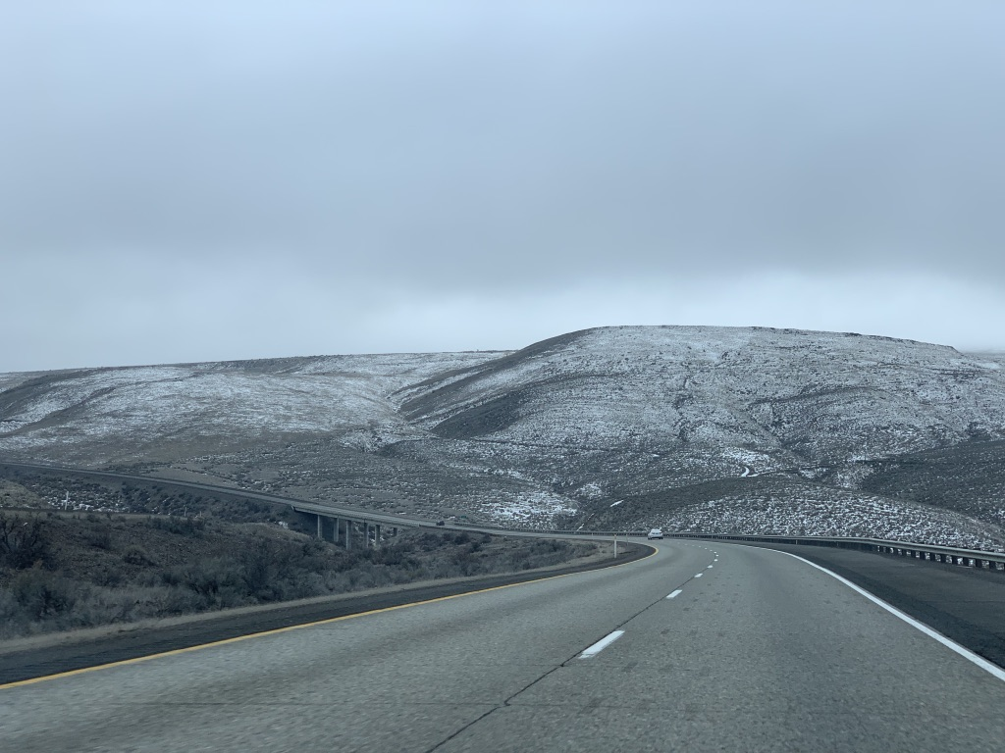
Road Trips
Notes:
Road Trips are possible in many but not all electric vehicles.

Slide 40
EV Road Trips
Mid- and long- range batteries are great for road trips!
Planning is key; some cars help navigate to chargers
En-route
Fast charging (Level 3)
“evGO” fast charging CCS or CHadEMO
Tesla Supercharger
Slower charging (Level 2)
Movie theater, shopping mall
ChargePoint or other paid EV network
Municipal charging
Destination-based
Your uncle’s garage plug
Camp site RV plug
Hotels or AirBnB’s with Level 2 EV charging equipment
Notes:
Road Trips are possible in many but not all electric vehicles.
Planning is key because there are not always chargers along a route, and charging fast can be really hard to find in some spots.
This section may feel like an advertisement for Tesla, because Tesla has heavily invested in the best network for fast charging on the go!
Some cars will help plan your route by suggesting charging opportunities along your navigation route, but you may also need to go to plugshare and other apps to find options.
A lot of people charge EVs while camping, for example, and travel with an RV plug adapter!
While on a road trip, a Level 2 charger is only useful OVERNIGHT. You need to find Level 3 chargers to efficiently travel if you are going further than the distance of your car’s range.

Slide 41
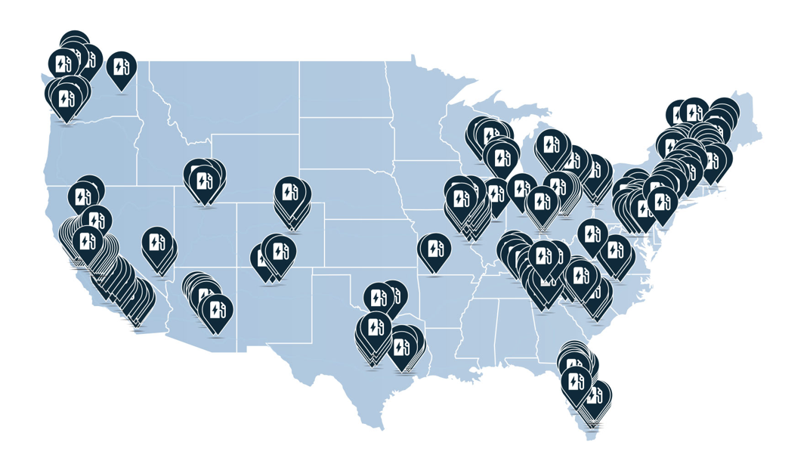
EVgo
DC fast charging
$0.20-$0.35/minute varies by state
Various adapters: J1772, CHadEMO, CCS
$1.50/hour Level 2 charging
Network growing
In 30 minutes charges up to 75 miles
Notes:
EVgo is a paid fast charger network for almost all types of electri cars. In a 30 minute charge you can get 75 miles of range. Note that there are not EV fast chargers country-wide, so you cannot go everywhere with their network. It will get larger over time.

Slide 42
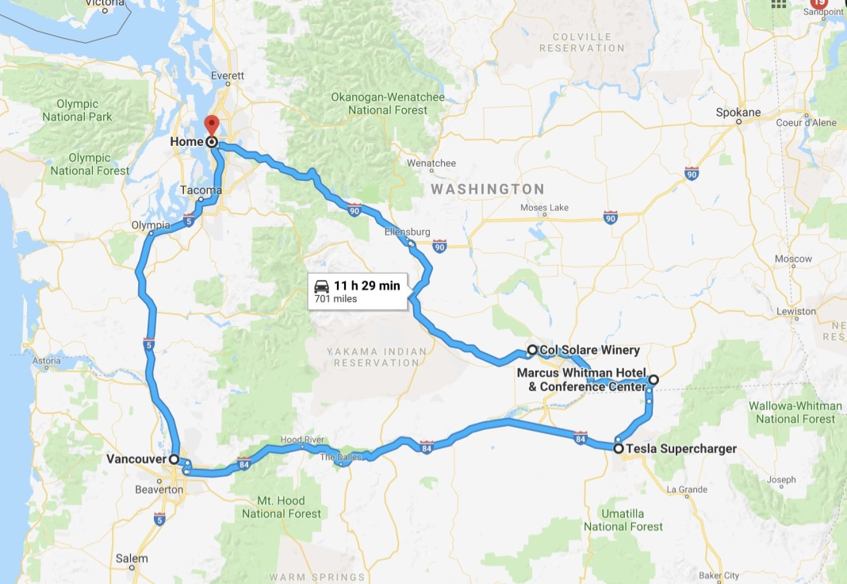
Notes:
Here is an example route that Jeff took on a recent roadtrip from The Vine to Eastern Washington, then south to the Columbia River and following the border in Oregon to then get to I-5. A 2-day trip, it made extensive use of the Tesla Supercharger network and also a hotel having a Level 2 destination charger available at it for an overnight charge.
In all, 701 miles of driving.

Slide 43
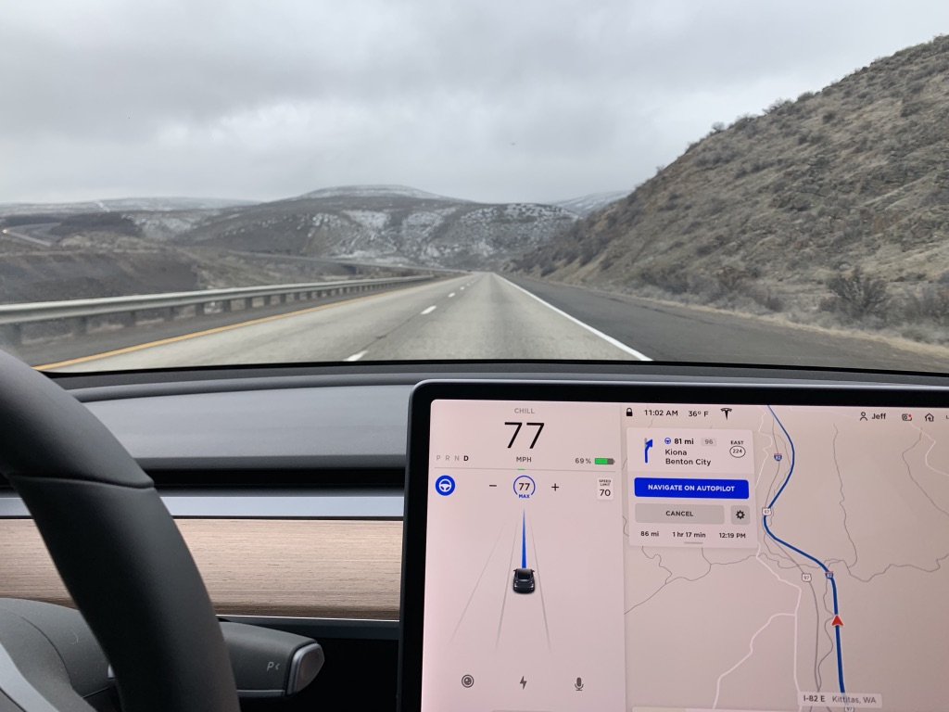
Notes:
Driving near Yakima.
Older electric cars have issue in the cold. Here it is 36 degrees out and the car is performing just fine in the mountain ranges.
The blue line in this display indicates that the car is using AutoPilot steering mode to stay in the lanes and partially drive itself on the highway.

Slide 44
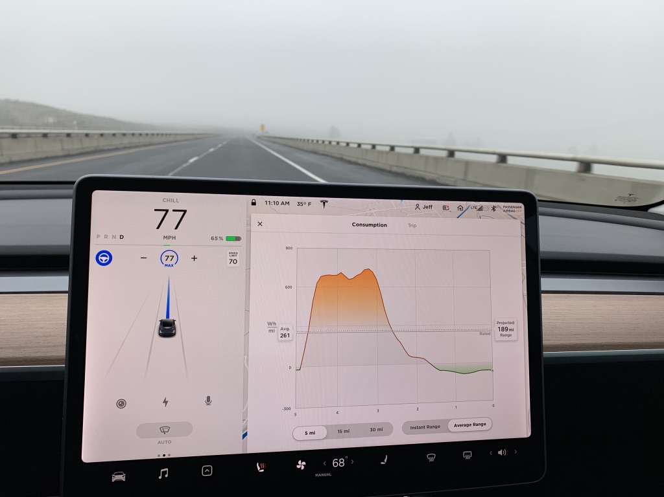
Notes:
The Energy Consumption display in the Model 3 shows what it looks like coming off of a big mountain range: more energy use going uphill, and then downhill, it’s actually generating more energy from the downhill, meaning it is charging the battery up!

Slide 45
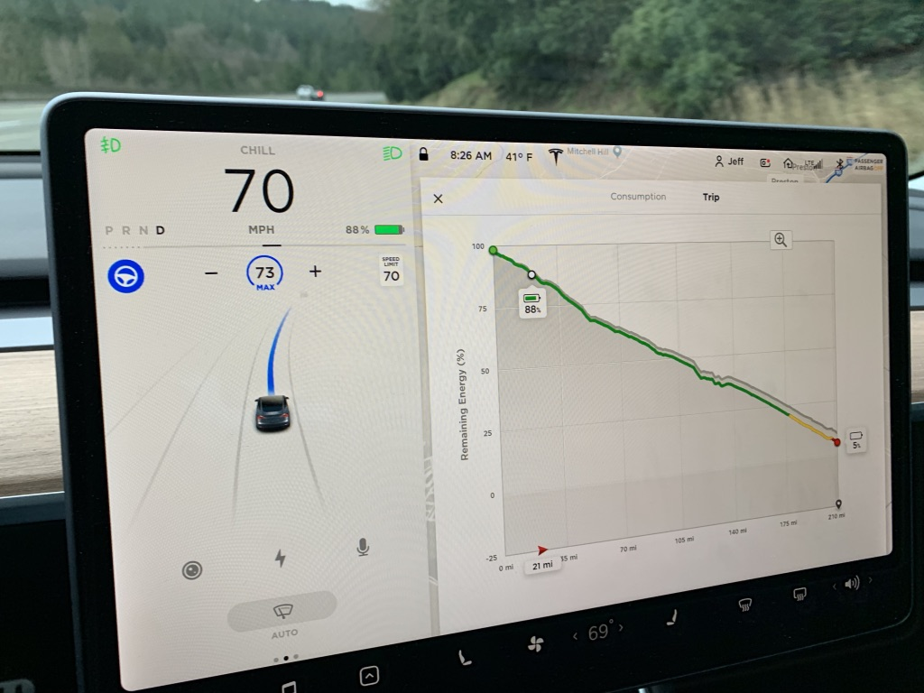
Notes:
The navigation system plays into the trip planner views. Here, the destination is programmed, so it estimates the use of charge over the hills and mountains on the way and tracks progress to the destination.

Slide 46
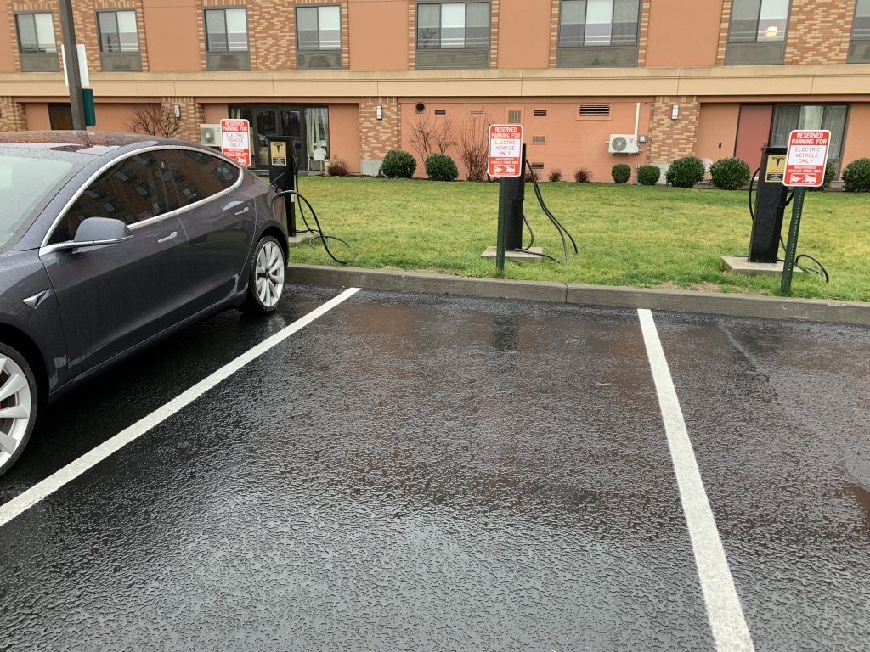
Marcus-Whitman Hotel, Walla Walla
Free for hotel guests
2 Tesla chargers
1 J1772 charger
Notes:
Many hotels have Tesla and regular Level 2 car chargers. Here is the Marcus Whitman hotel in Walla Walla, WA; they have 2 Tesla chargers and 1 standard J1772 EV charger, free for their registered hotel guests to charge up.

Slide 47
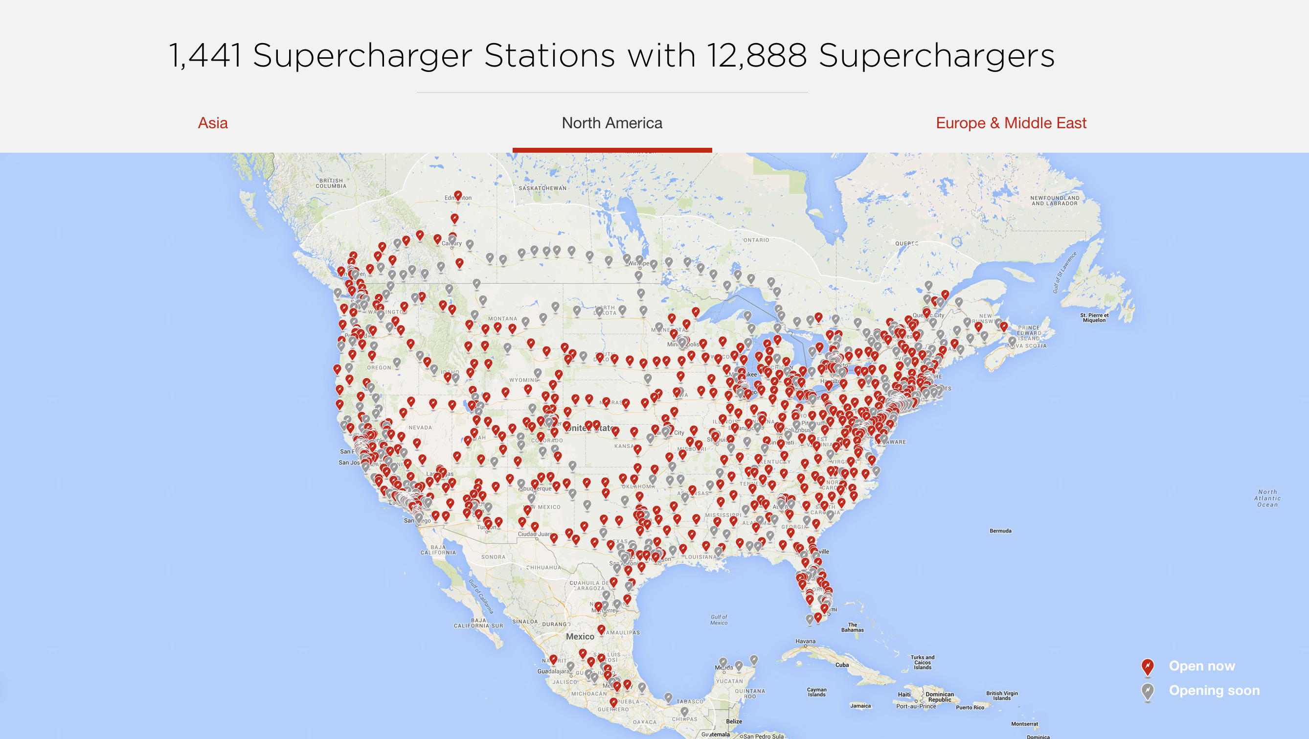
Notes:
Tesla’s Supercharger network is made for road trips and nearly all major highways have options for getting around and charging.

Slide 48
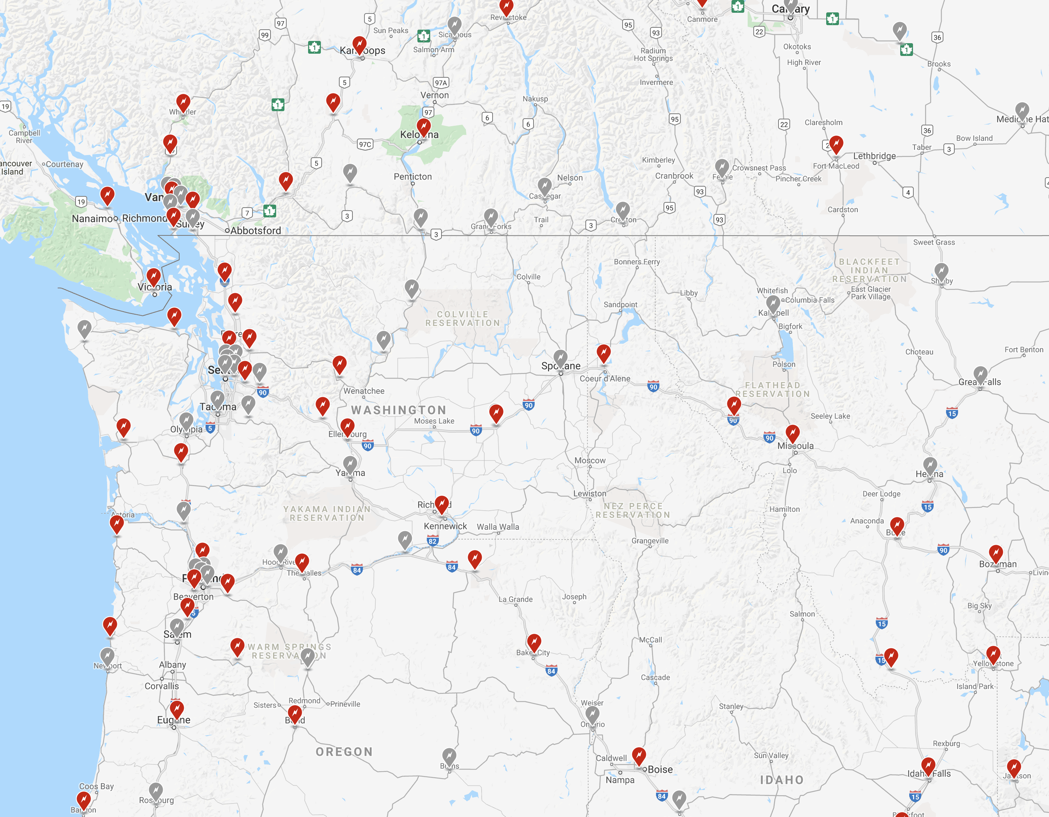
Notes:
Here’s a zoom in to the Pacific Northwest and its Tesla Supercharger locations.

Slide 49
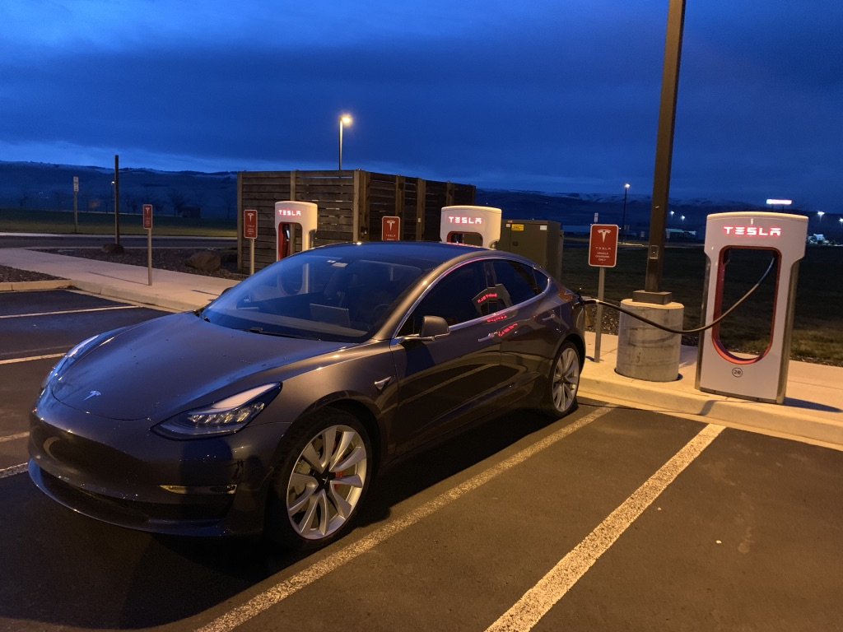
Notes:
A supercharger along the Blue Mountains.

Slide 50
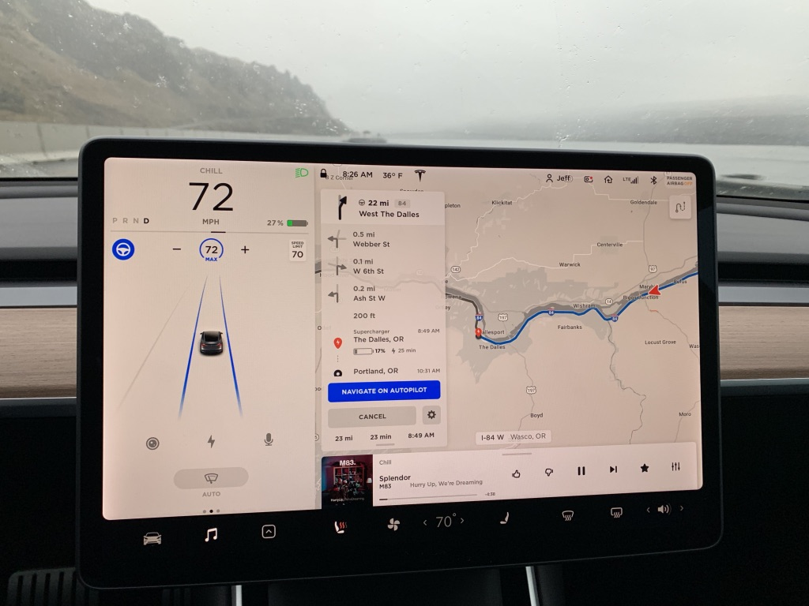
Notes:
The navigation system recommends Tesla Supercharger locations along your route, and suggests how long to ‘supercharge’ at a spot (no need to fully charge up, you just need enough power to make it to the next supercharger spot, or home, or a hotel!)

Slide 51
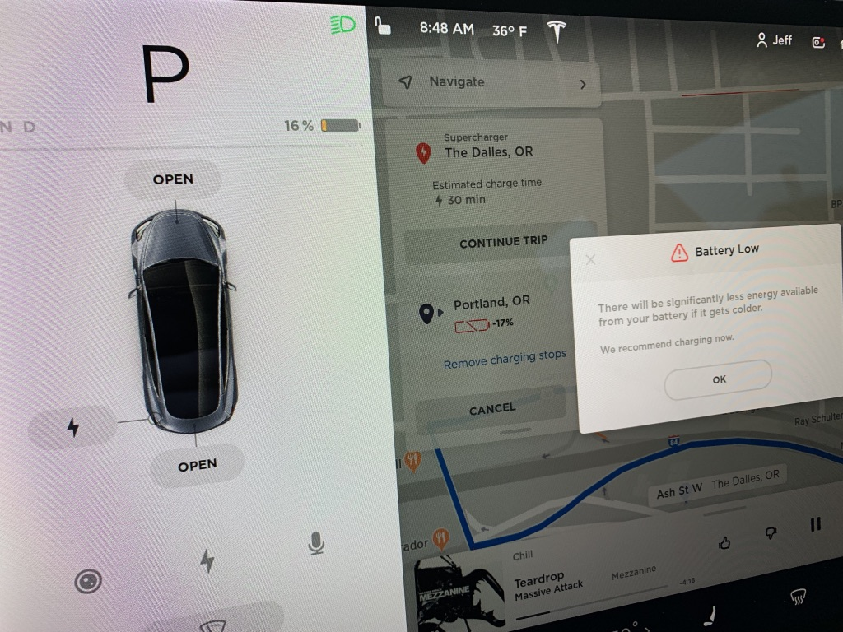
Notes:
One part of the trip had a very long drive between chargers, eventually noting that its important to charge ASAP!

Slide 52
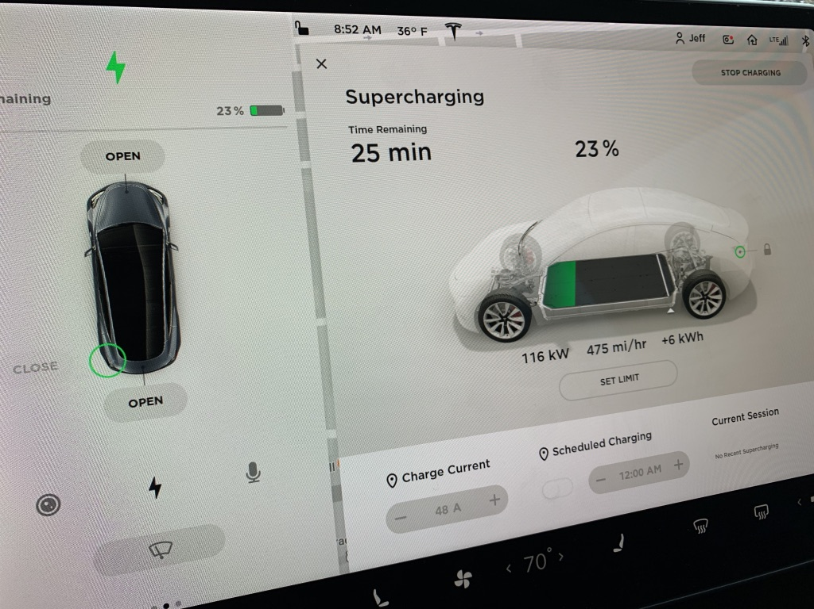
Supercharging
475 mi/hr. of charge
Only charge what you need to reach your next destination
Notes:
Supercharging is fast.
Here you can see the car is receiving 116 kilowatts of power an hour delivered, and so it is charging effectively at 475 miles per hour of range!

Slide 53
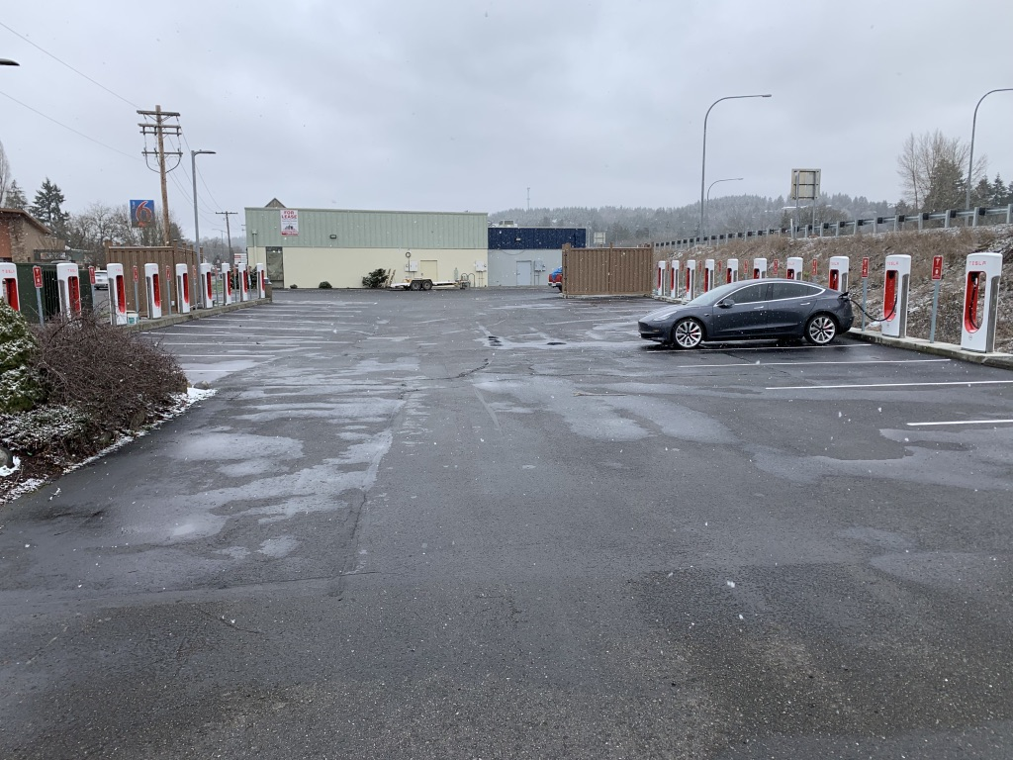
Notes:
A large Supercharger station in Centralia, WA… located at a factory outlet mall near a few restaurants and stores. Lots of charging capacity along I-5!

Slide 54
Our paid, shared EV amenity

Slide 55
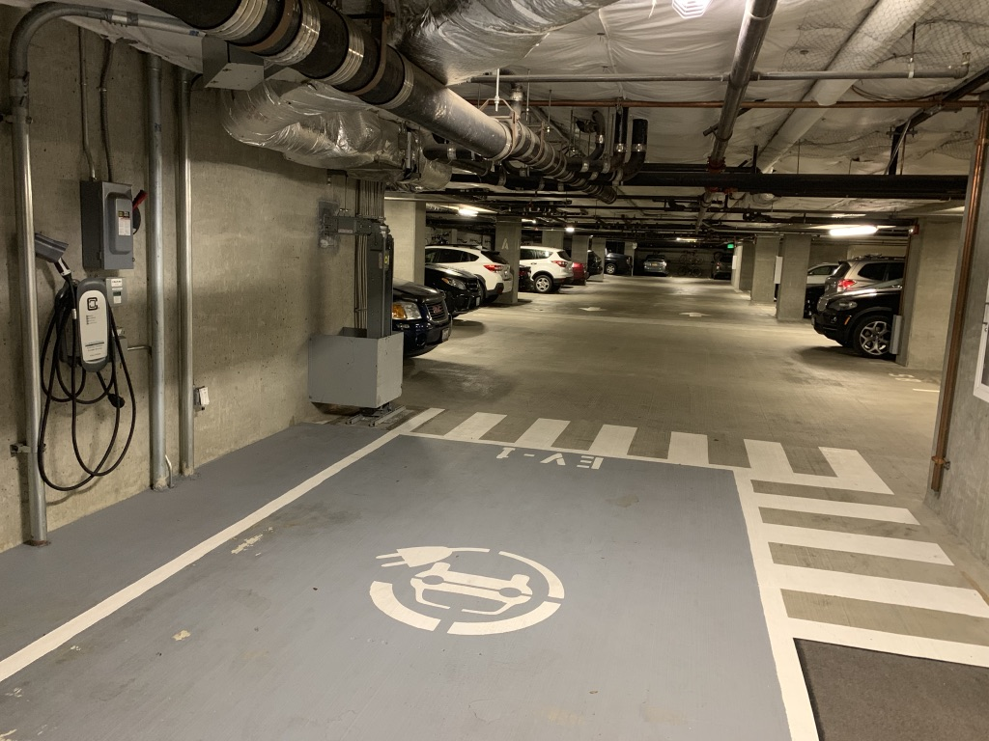
Amenity
Level A (South Entrance) Garage
Level 2 Clipper Creek EVSE
Locked 14-50 Outlet
$1/hour
Daily limit of 8 hours currently
Overnight option exists
Notes:
This is the Level A (south garage entrance) parking space and charging equipment as a paid amenity. Super useful.

Slide 56
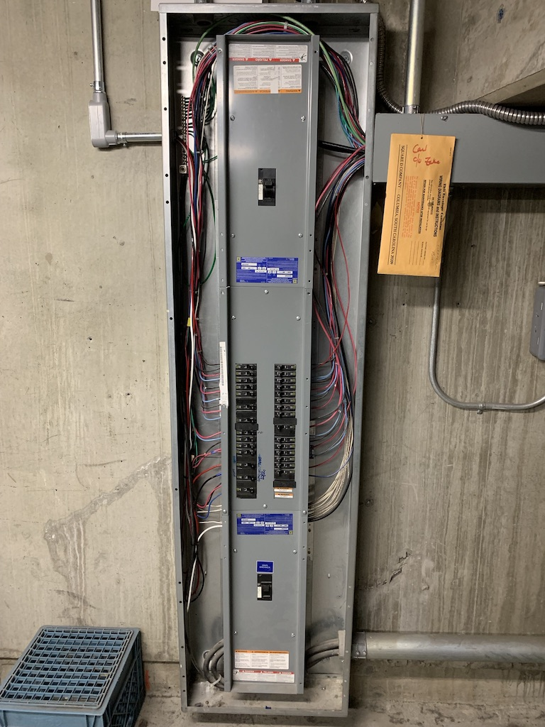
Community Electric Panel
Various garage circuits
EV charging circuit
EV charging sub-meter
Notes:
This is the electric panel that powers much of the garage and the community charger.
It’s very full. There’s no space here physically or through capacity/permit reasons to put additional chargers in this specific ‘LB’ panel in the main electric room.

Slide 57
Community charger
Benefits
Great!
Relatively low cost
Convenient
Has allowed a few owners to have/use EVs
Challenges
Will not encourage broad EV ownership
Located in the A garage (not available easily to B garage users)
Having to relocate and move the car
Lock/key requires front desk staff to be available
* note: there is not demand for additional community chargers (nor available community-owned parking spaces)

Slide 58
Electrical Capacity Limited Common EV Charging
Notes:
Looking forward, we would like to build a policy and reservation program to allow people to install, at their own cost, chargers in their Limited Common parking spaces for their exclusive use. Very important to EV drivers and future EV owners to have the choice if they want to invest in that vs using the community charger. This way they know they could always wake up to a full charge each day and pay for just what they use, not their time charging.

Slide 59
Limited Common Charging Goal
Owners would like a policy/program in place to set the guidelines for installing EV chargers in their unit’s Limited Common parking space(s)
Many other Seattle condo buildings have helped guide the way; some created policies as early as 2011
Convenience is a key factor
Individuals should bear the cost of their installations, not the association
A reservation payment process
Setting guidelines for energy sub-metering and program fees

Slide 60
Electricity!
We have two electrical service switchboards
MDS-1: Residential
MDS-2: “House” (Common/Garage/etc.) + Commercial Units

Slide 61
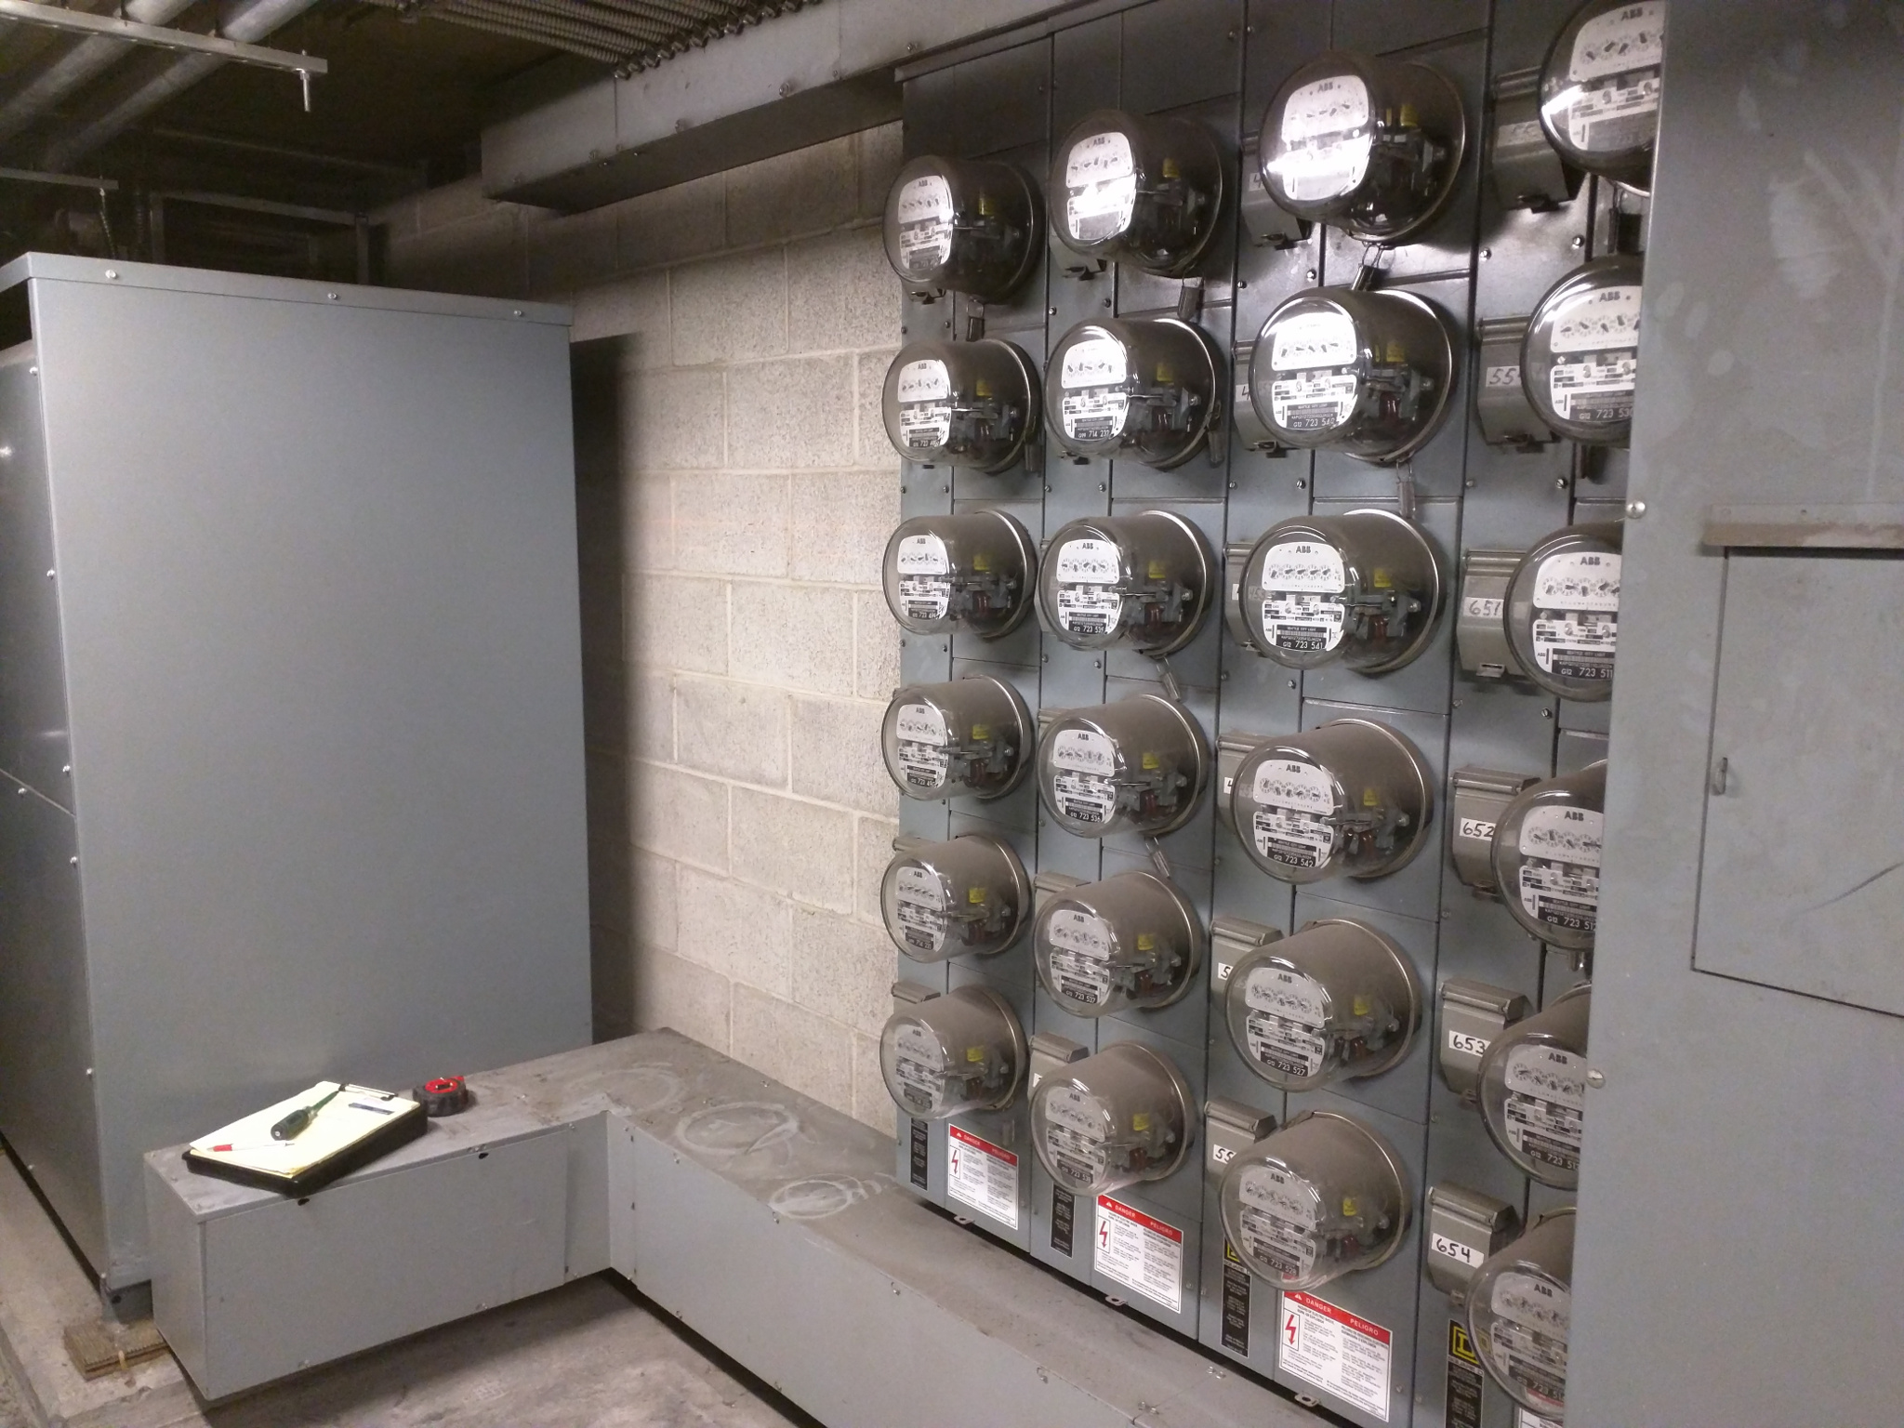
Residential Switchboard MDS-1
Fully demand rated for all residences
A major study of all appliances would be required to allocate additional energy
MDS-1 service is not available for EV charging
Notes:
MDS-1 is where all residential power comes from. That service cannot be used for EV charging without doing a full audit of all appliances in the building, units, etc. It’s best to leave the residential system as-is.

Slide 62
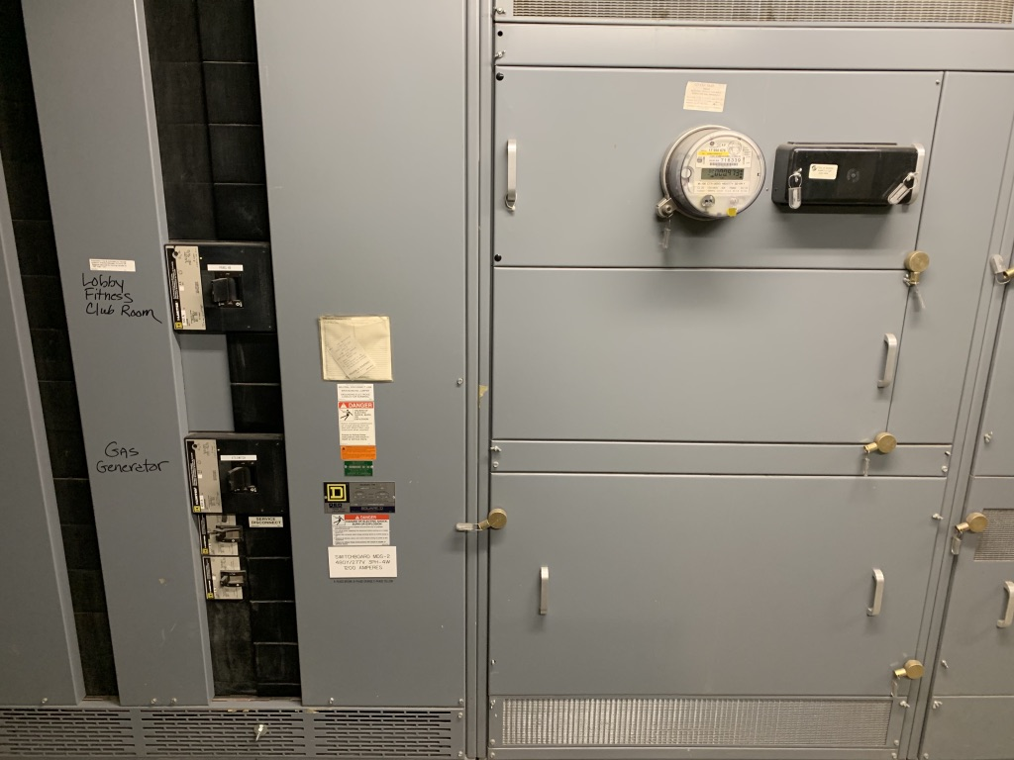
House + Commercial Switchboard MDS-2
Commercial Seattle City Light “Peak Demand” Meter installed in 2017
Current peak use over 12 months: 11% of capacity
MDS-2 is ideal for EV charging for the long term
Notes:
MDS-2 is the commercial and “house” (house == common areas, garages, lights, etc.) service.
Per the city’s demand data recently shared in December 2018, the MDS-2 service is using at peak 11% of its large amount of power service available. Huge headroom for EV charging to use this electric service!! This is a major development and news we did not have in 2016-2017 during the last EV committee project to try and move this program forward. As a result, the cost to install a panel and transformer for EV use is significantly lower than previous quotes. The cost will likely be under $15,000, as opposed to prior estimates around $35,000. Big win. This also means it could fairly be split across up to 10 owners just fine.

Slide 63
Necessary electrical upgrade
New 42-space panel, transformer and switchgear breaker can be installed OTC permit
Panel and capacity would support 8-10 EV Level 2 20-amp, 32-amp breakers (varies) with OTC permits
Bids around $15,000 cost to provide capacity for 10 circuits
EV circuit reservations
Circuit Reservation Price TBD: $1,500 minimum, $2,500 proposed
Flexibility to owners to install at any time in the future
Reservations are associated with limited common parking spaces; can sell/move spaces/unit/reservations
Future demand would require kicking off another cycle/project
Note: Immediate capacity above OTC limits require engineering, plan and city studies (cost prohibitive)

Slide 64
How to pay for the electrical upgrade?
Circuit Reservations
Proof of Demand with Payment Offset to HOA Board
A few initial reservations with payment will demonstrate enough interest to greenlight to upgrades and program
Payment comes directly from those who benefit from the Limited Common improvement
After enough reservations, the entire upgrade will have been paid for; $0 cost to the association
If all reservations are filled, the association will have net positive funds for additional investment
When should an owner reserve?
If an Owner has an EV they want to charge today
Have an order placed for an EV
Serious about purchasing an EV in the coming year(s) and want to get ready

Slide 65
Infrastructure Upgrade Funding Options
Preferred Option A No long-term association cost; association income optional
3-4 initial reservations to approve project
Determines initial association cost
Long-term zero association cost or even income
Association greenlights upgrade once 3-4 reservation checks are deposited. Over time it builds an account/surplus to save for other EV investments as needed.
At a $2,500 reservation cost with 4 reservations, the initial HOA cost is $2,504.
At a $1,500 reservation cost with 4 reservations, the initial HOA cost is $6,504.
This is based on the best of several initial quotes placing a project cost at $12.5k. Board should assume price could approach $15k for contingencies.
Alternate Option B 100% reservation fees, immediately
Sell all 10 reservations at anticipated cost
Require reservation resales to be at or below cost between owners
May require fairness rules limiting time to install before forfeiting
Greenlight project at 10 reservations
Likely reservation fee ~$1,500 each
Alternate Option C 100% reservation fees, immediately, including sub-meters
Sell all 10 reservations at anticipated cost
Require reservation resales to be at or below cost between owners
May require fairness rules limiting time to install before forfeiting
Greenlight project at 10 reservations
Lumps in upfront purchase of 10 sub-meters to reduce individual install costs
Includes sub-meter mounting and conduit
Likely reservation fee ~$2,150 each
Decision owner: the HOA board
Input: the community + EV committee
Notes:
Option A is the preference for the program, but other funding models such as selling all reservations up-front are possible. The board is the decision maker on both the cost of reservations and the approach used.

Slide 66
3 Proposed Fees (amounts subject to board feedback + approval)
Reservation Fee
$1,500-$2,500 (TBD – this is an approximate ballpark range)
One-time fee for a reservation, as capacity remains available
Covers a share of the electrical system and panel dedicated to EV chargers
Program Operations Fee
$50 annual fee for active installations (energy turned on to an installed circuit)
Covers credit card fees, staff time for quarterly meter reading
Energy Use Payment
Quarterly sub-meter readings for active installations
Kilowatt hours at-cost: The Vine’s current electrical rate (will adjust, typically annually)
Charged to the amenity credit card account on file or by other means
Decision owner: the HOA board
Input: the community + EV committee

Slide 67
Individual owner installation cost estimate
To HOA: Circuit Reservation Fee
TBD: $1500-$2500
To Electrician: Installation and Parts
$1,000-$5,000 estimate (or more)
Owners interested in reservations should get a quote before making a reservation to understand the risks, installation specifics, need for penetrations or unique circumstances, mounting options, and any challenges
Costs may include
Electrical permit and inspection fees to/from the city
1 day or more electrician time at $110-$125/hour
Wire (expensive cost per foot)
Conduit, connectors, electrical
Part: Approved revenue-grade sub-meter ($500)
Part: Approved outlet or EVSE equipment ($5-1,000)
Part: Emergency disconnect switch (if required per code)
Mounting equipment or bollards or posts and other protective devices

Slide 68
Proposed EV Program Launch Process
Gauge serious community interest (now)
Checks made out to the HOA
Process and procedure TBD, please e-mail if you want to consider
HOA board policy feedback & introduction (Feb/March)
Needs to determine appropriate level of interest to continue with process
HOA board input is needed on policy details, specifics, pricing
Rule changes have a 30-day minimum approval time period
HOA board policy approval (March/April)
Deposit serious interest checks for initial reservations
Greenlight necessary electrical upgrades (Feb/March/April)
15- to 60-day lead time for permits, equipment purchases, installation and inspections
Program live (after approval)
Reservations as-available, table updated by building manager & approved monthly by board
Installations, within policy guidelines, performed anytime after building manager approval

Slide 69
Q&A

Slide 70
Q: Future demand
Q: What happens when demand exceeds the available number of EV circuits?
The same process and plan (transformer, MDS-2 breaker, OTC permit) can be used again
Would be important to first try and fully utilize the first set of reservation circuits instead of greenlighting too early
May need to review reservation rules (per policy – see section 3) if demand spikes
Eventually a different location may be necessary for the transformer and panel (comms room or level 1 or level 2 tower IDF rooms)
A larger transformer or demand project would require hiring an engineering firm, having a city demand review, and other work

Slide 71
Q: Sub-metering
Q: Are there alternatives to sub-meters?
A: Yes. There are 5 possible approaches. Feedback welcome.
Approach | City Meters | Circuit Sub-Meters recommended approach for The Vine | EV Panel Sub-Meter | Fixed Monthly Cost (No Meters) | Intelligent EVSE Networked Devices with Metering
Impact | A bill comes direct from Seattle City Light for use. No accounting or involvement from our staff in the operations. | Most fair approach: users pay for what they use. | A single, more expensive sub-meter measures all the Limited Common EV chargers. Users pay their share per quarter, regardless of how much they charge their car. | Taking estimated EPA charging costs of the average EV, plus a buffer, and simply charge $25/month per circuit regardless of use | Commercial entity provides automatic billing services. Owners use special smart card tags to start charging. Cost per EVSE is as high as $6,000 ☹ on top of install cost
Challenges / Opinion | Our meter stacks have been discontinued by the manufacturer and so used meter stacks would need to be sourced somehow. The meters would take significant physical space. Not an option for our building. | The specific, most common E-Mon D-Mon revenue-grade sub-meters add $400 or so to the cost of each circuit. Recommended approach for usto ensure fair use. | Not very fair to people who do not use their car as often. Adds $2,000 to the upgrade cost to cover the sub-meter. | If all EV drivers regularly drove a lot and charged a lot, their energy cost per month could easily exceed $25. If our EV drivers only drive in the city, their costs could be substantially lower, reducing value vs gas cars. | More common only in commercial spaces. Networked systems such as ChargePoint charge an annual port fee of over $400 per charger to manage the system on-behalf-of.
Buildings with that approach in place | Insignia (new construction) | Bay Vista Tower | No known Seattle condos | 2200 Escala | No known Seattle condos Expensive long-term costs

Slide 72
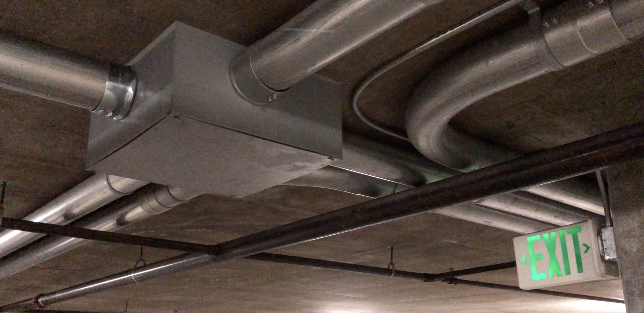
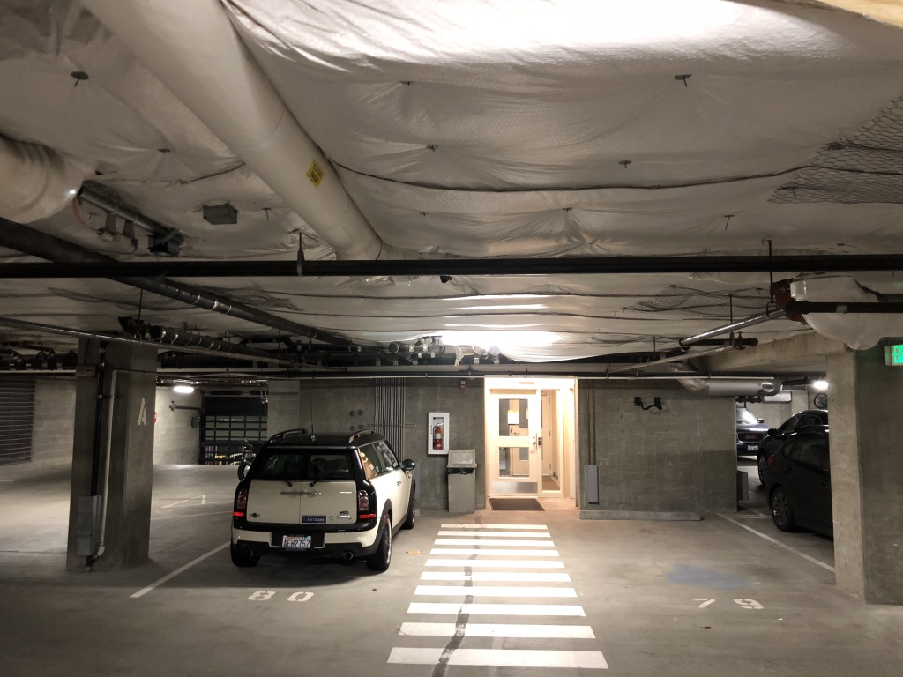
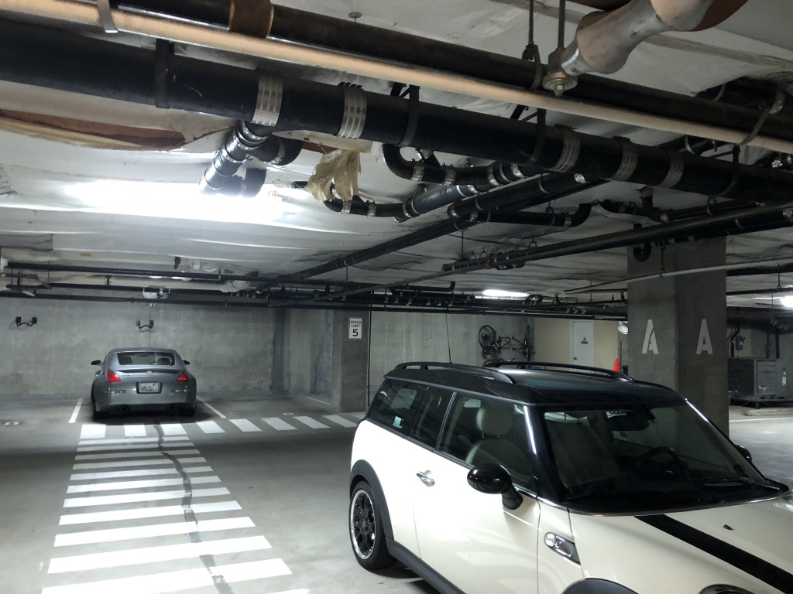
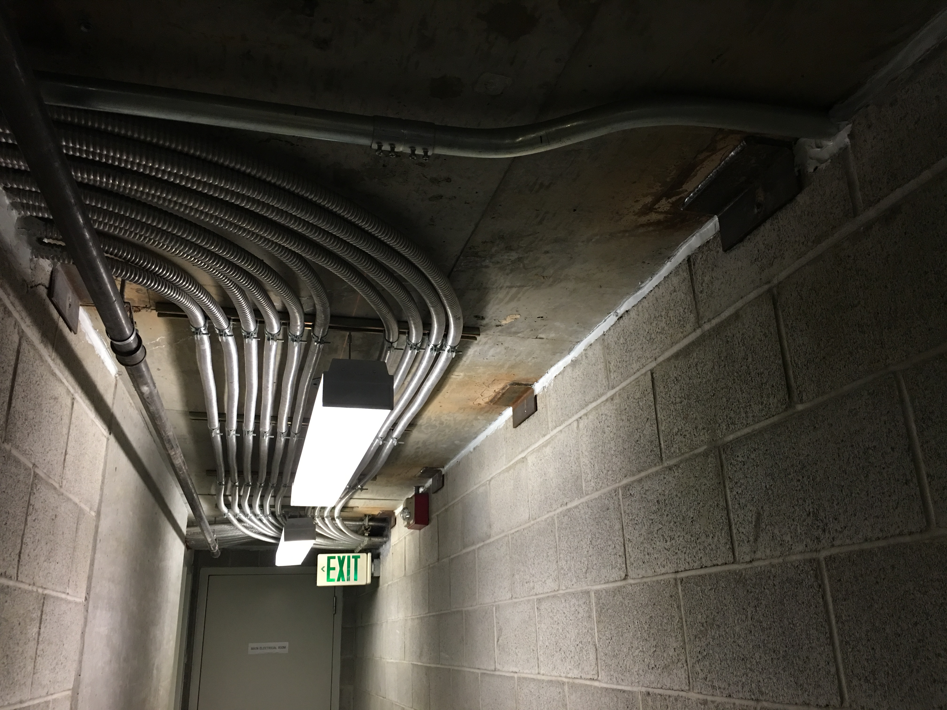
Q: Conduit
Isn’t conduit ugly?
The garage is full of conduit!
It’s code and necessary
Multiple circuits in conduit are possible if owners work together in some situations
Many units in the building already have limited common conduit running to them along the garage walls/ceiling

Slide 73
What have others done?

Slide 74
Bay Vista
Similar for 2200 Condos, too
Notes:
Similar to the approach we are considering, it’s most fair.

Slide 75
Escala
Community fully funded electrical upgrades to reduce circuit costs
Notes:
Escala used community funds to upgrade their electrical infrastructure for the benefit of the owners who wanted to charge EVs. As a result, their ‘reservation’ fees are essentially $500 per circuit. The Vine does not at this time see this as a fair approach given that community funds should not necessarily be subsidizing private charger installations.

Slide 76
Insignia
Sales-time allocation initially
Notes:
Newer buildings sell EV access at condo sales time similar to upgrading backsplashes.

Slide 77
Next Steps

Slide 78
Next Steps
Input & feedback on this proposal in the process of submitting to the HOA board: (EMAIL ADDRESS)
Want to reserve now? Prepare to make a reservation payment by check (amount TBD) to the HOA and notify (EMAIL ADDRESS)
Consider attending February and March HOA meetings
With checks for 3-4 reservations (board must approve specifics, TBD), solid path to greenlight the electrical upgrades
Without enough interest, will have to wait and see again

Slide 79
Walking Tour

Slide 80
Sites
Level A: EV-1 community amenity
Main Electrical Room
Garage Walkthrough
Tour EV vehicles in the garage

